Slide 1

Basic Electricity
Basic electrical concepts
Except where otherwise noted these materials
are licensed Creative Commons Attribution 4.0 (CC BY)

Slide 2
Objectives
The objective of this unit is to present the student with some basic terms relating to electricity. Upon completion, the student will have an understanding of the following:
  Basic atom structure
  Key terms and definitions
  Basic circuit analysis and recognition of differences
  Basic notations and conversions
For any calculations made, it is critical to carry proper units. An answer is incorrect if it is not identified properly.

Slide 3
The importance of the atom
Atom Structure
  Made up of electrons, protons, and neutrons
  The nucleus contains the protons and neutrons.
  The shell contains the electrons, which orbit the nucleus.
  The building blocks of matter
The atomic structure of a material will help to determine the ease of current flow
  Atoms can be charged.
    Positive
    Negative
    Neutral
Law of Charges: Like charges repel each other, and unlike charges attract each other.
  A material that has an excess of electrons will take on a negative charge.
  A material that has fewer electrons than protons will have a net positive charge.

Slide 4
Electrical Materials & Photons
Electrical materials used
    Insulators: Materials that inhibit the flow of free electrons; this material has only a few free electrons
    Conductor: Materials that readily allow for the flow of free electrons and have many free electrons
    Semi-conductors: A material that has more free electrons than an insulator but fewer free electrons than a conductor
Photons
  The basic unit of light energy
  Light can be considered to consist of a stream of tiny particles of energy called photons.
    This is used in Solar Photovoltaics and helps with the creation of electricity.
    P-N Junction could be considered the heart of the solar cell.

Slide 5
Electricity for Renewables
Direct Current-DC
  Current flows in one direction only.
  Car Battery
  Photovoltaic cells
Alternating Current-AC
  Current flows in one direction, then the other, and alternates back and forth.
  This is what is used in one’s home single phase.
  Can be transformed

Slide 6
Examples of DC & AC Currents
Northeast Iowa Community College [CC BY 4.0]

Slide 7
Flow of Electrons through Conductor
Current: The flow of electrons through a conductor
  Measure in Ampere
  Measured with Amp Meter
  Electron Current flow
          Negative to positive flow
  Conventional Current flow
          Positive to negative flow
Northeast Iowa Community College [CC BY 4.0]

Slide 8
Understanding Voltage
Voltage: Pressure or force that pushes current through a conductor
  Measured in volts
  Can be measured with or without current flow
  Measured with volt meter
  Potential difference between two points
  A battery or PV source provides a DC power source
  A rotating generator could produce AC
  Some power supplies that convert AC to DC or DC to AC
Northeast Iowa Community College [CC BY 4.0]

Slide 9
Electricity for Renewables
Resistance: Opposition to current flow
  Measured in ohms
  Measured with ohmmeter
Power: The rate of work or energy consumption
  Measured in watts
    Measures the rate at which energy is used in a circuit

Slide 10
Understanding the Circuit
A practical circuit contains the four following characteristics:
  Load: A load consumes power
  A switch to control load for safety
  Power supply: Photovoltaic source to produce potential
  A path for electrons to flow - Wires in the circuit
Northeast Iowa Community College [CC BY 4.0]

Slide 11
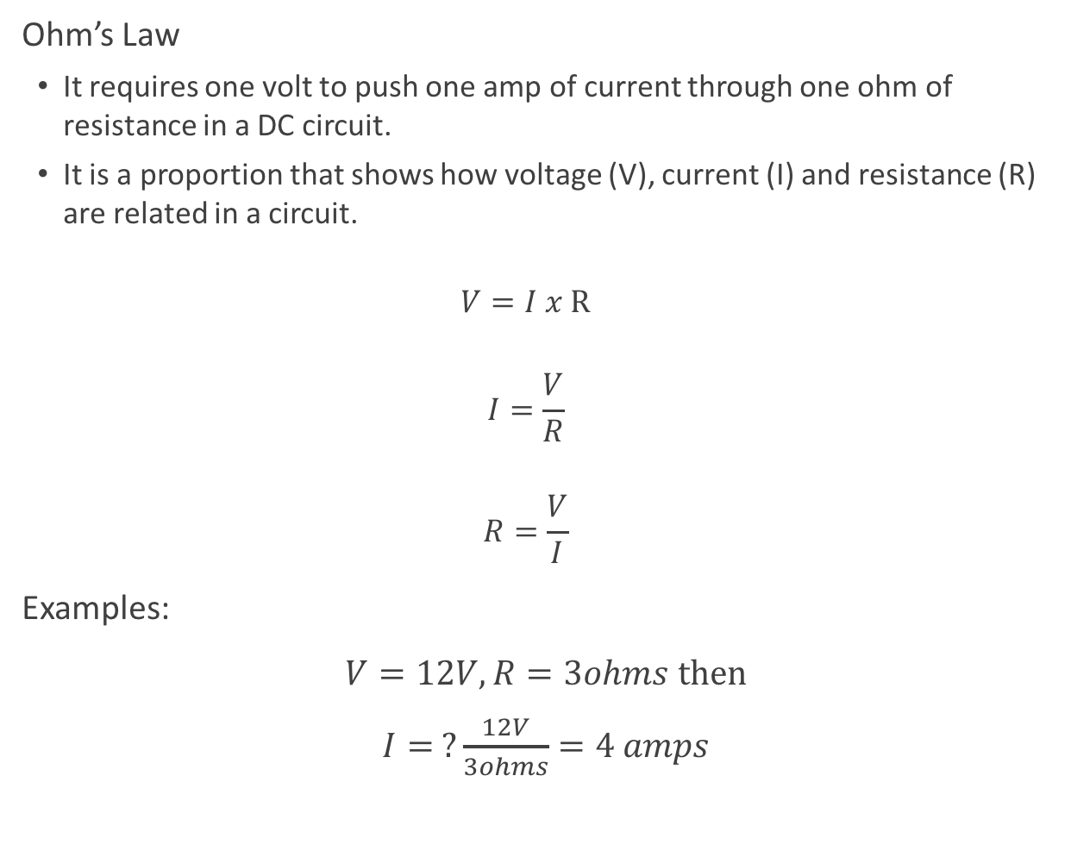
Ohm’s Law
Ohm’s Law
  It requires one volt to push one amp of current through one ohm of resistance in a DC circuit.
  It is a proportion that shows how voltage (V), current (I) and resistance (R) are related in a circuit.
  $$V=I x R$$
  $$I=\frac{V}{R}$$
  $$R=\frac{V}{I}$$
Examples:
$V=12V, R=3ohms then$
$I= ?\frac{12V}{3ohms}=4 amps$

Slide 12
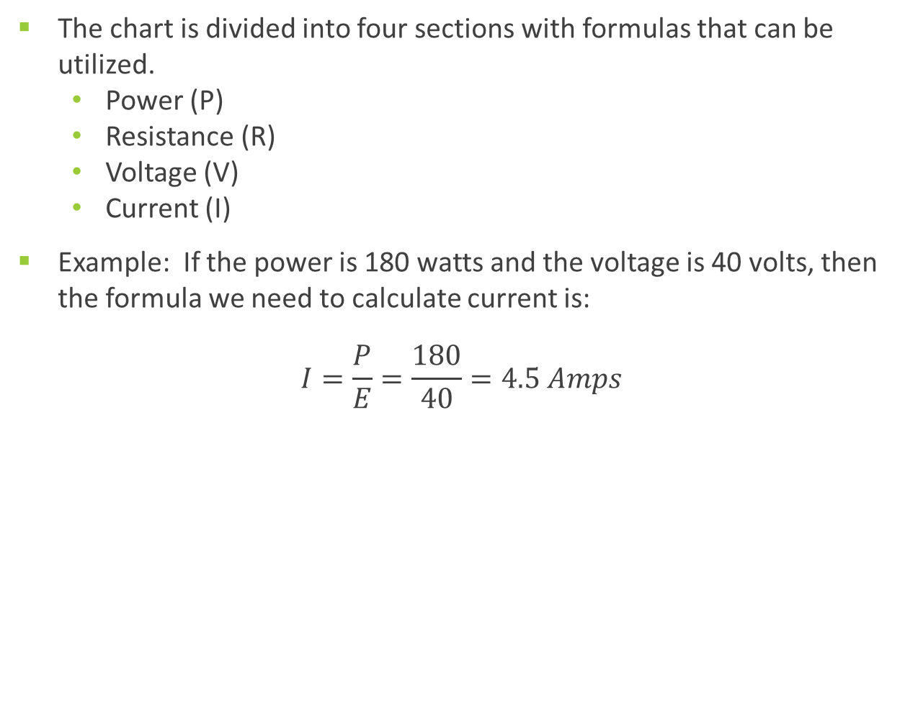
Identifying the Equation
The chart is divided into four sections with formulas that can be utilized.
  Power (P)
  Resistance (R)
  Voltage (V)
  Current (I)
Example: If the power is 180 watts and the voltage is 40 volts, then the formula we need to calculate current is:
$$I=\frac{P}{E}=\frac{180}{40}=4.5 Amps$$
E²
R
P
R
P
E
E I
E
R
I²R
P
I
E
I
R
E
P R
P
I²
P
I
I R
E²
P
Northeast Iowa Community College [CC BY 4.0]

Slide 13
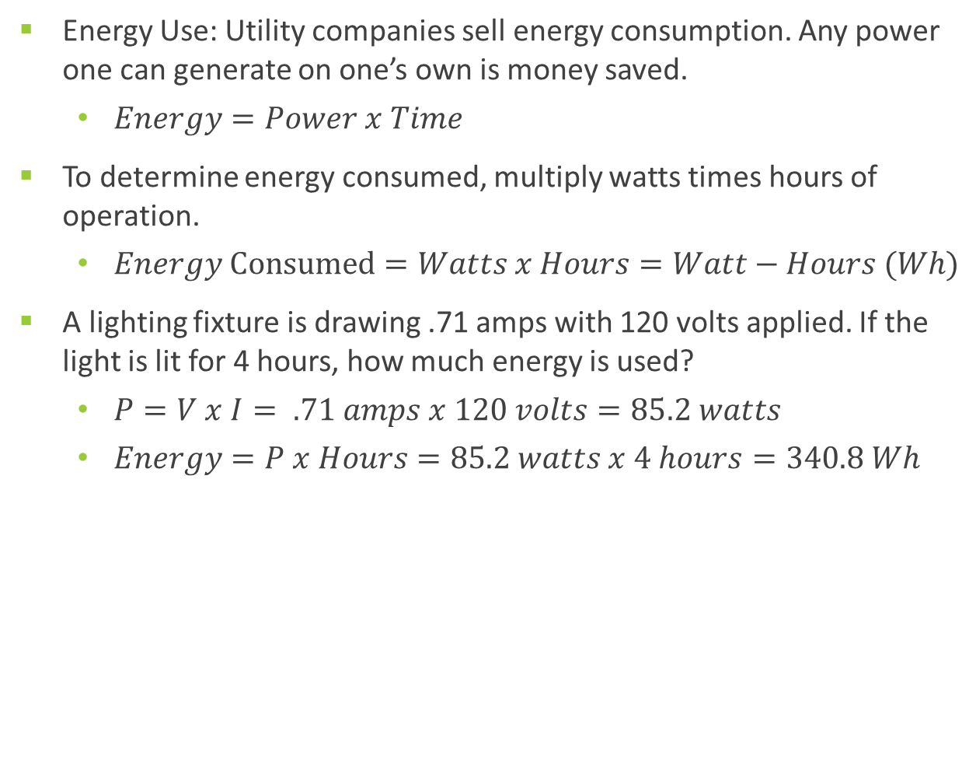
Equations for Energy Use
Energy Use: Utility companies sell energy consumption. Any power one can generate on one’s own is money saved.
  $Energy=Power x Time$
To determine energy consumed, multiply watts times hours of operation.
  $Energy Consumed=Watts x Hours=Watt−Hours (Wh)$
A lighting fixture is drawing .71 amps with 120 volts applied. If the light is lit for 4 hours, how much energy is used?
  $P=V x I= .71 amps x 120 volts=85.2 watts$
  $Energy=P x Hours=85.2 watts x 4 hours=340.8 Wh$

Slide 14
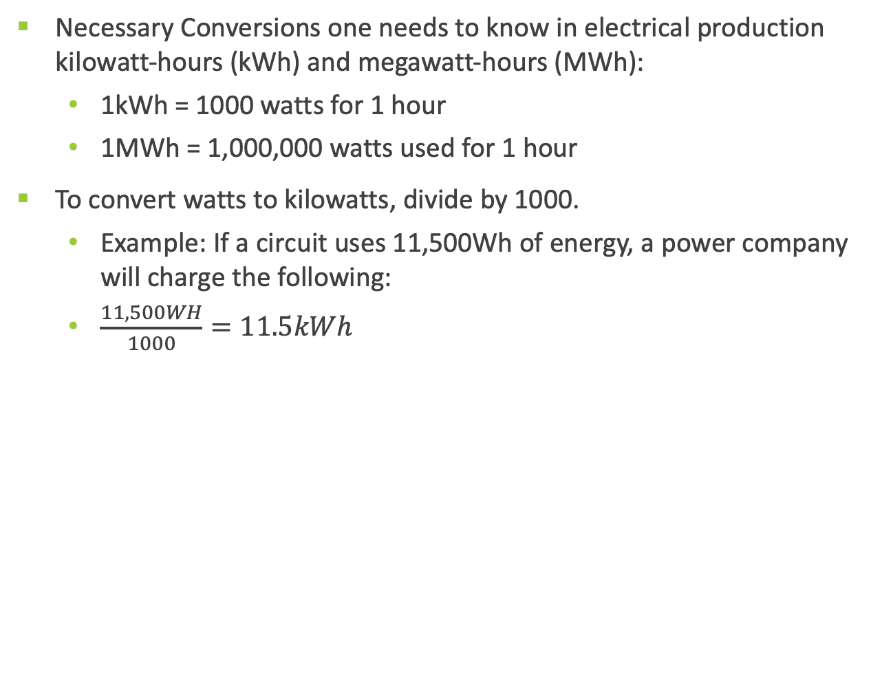
Conversions
Necessary Conversions one needs to know in electrical production kilowatt-hours (kWh) and megawatt-hours (MWh):
  1kWh = 1000 watts for 1 hour
  1MWh = 1,000,000 watts used for 1 hour
To convert watts to kilowatts, divide by 1000.
  Example: If a circuit uses 11,500Wh of energy, a power company will charge the following:
  $\frac{11,500WH}{1000}=11.5kWh$

Slide 15
Engineering notation with metric prefixes
Prefix | Symbol | Value
Tera | T | One trillion (1,000,000,000,000)
Giga | G | One billion (1,000,000,000)
Mega | M | One million (1,000,000)
Kilo | k | One thousand (1,000)
Milli | m | One thousandth (0.001)
Micro | µ | One millionth (0.000001)
Nano | n | One billionth (0.000000001)
Pico | P | One trillionth (0.000000000001)

Slide 16

Examples of Conversions
$1000W=1 KW=\frac{1000}{1000}$
$1,500,000 W=1.5 MW=(\frac{1,500,000}{1,000,000})$*
$0.0032A=3.2 mA=(\frac{0.0032}{1000})$
$0.00004A=40 microamps=(0.00004 x 1,000,000)$*

Slide 17

Series Circuit
One path for current to flow
  Total resistance is equal to the sum of the individual resistances.
  Total voltage is equal to the sum of the individual voltage drops.
  Current is the same throughout the circuit.
Laws that govern Series Circuits:
  $RT=R1+R2+R3+ …$
  $ET=E1+E2+E3+ …$
  $IT=I1+I2+I3+ …$
Northeast Iowa Community College [CC BY 4.0]

Slide 18
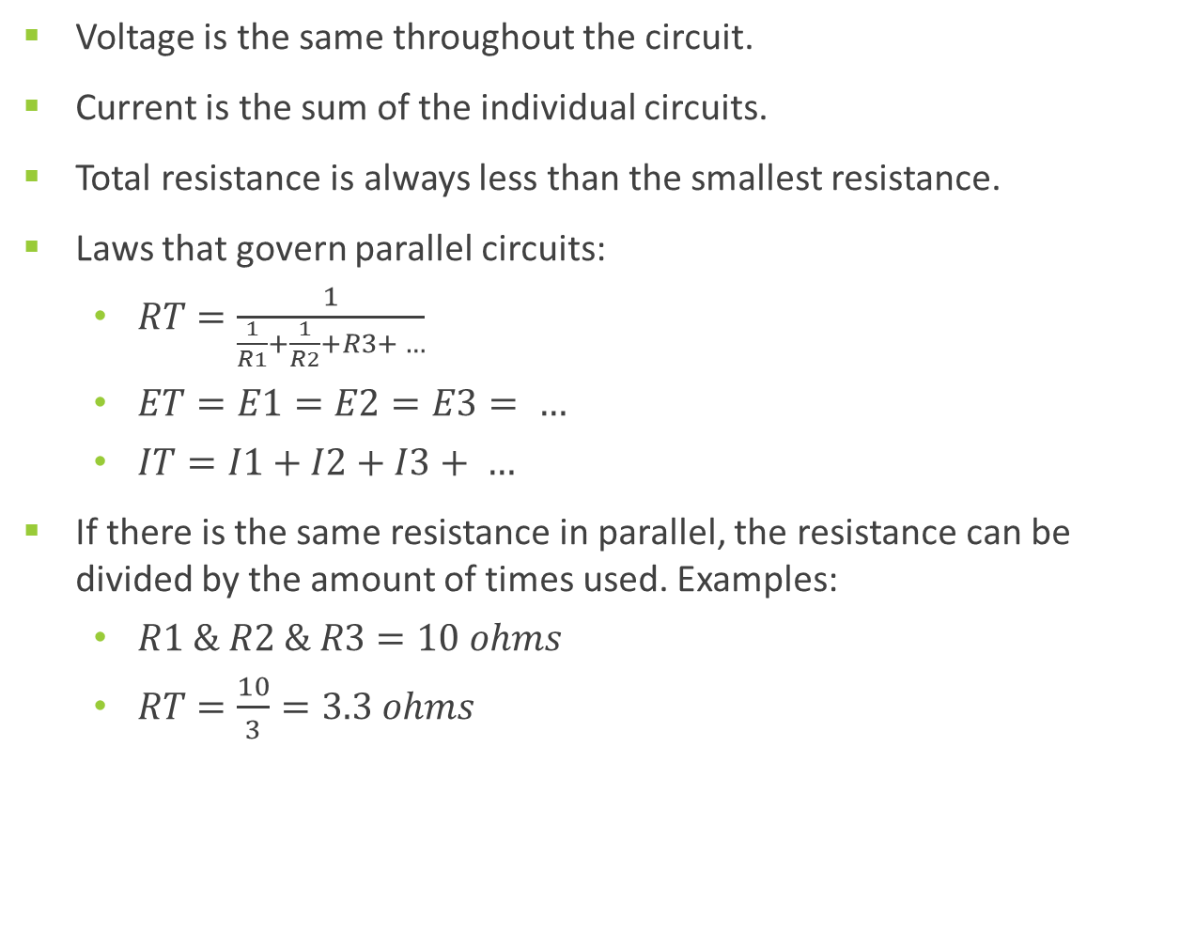
Parallel Circuits
Voltage is the same throughout the circuit.
Current is the sum of the individual circuits.
Total resistance is always less than the smallest resistance.
Laws that govern parallel circuits:
  $RT=\frac{1}{\frac{1}{R1}+\frac{1}{R2}+R3+ …}$
  $ET=E1=E2=E3= …$
  $IT=I1+I2+I3+ …$
If there is the same resistance in parallel, the resistance can be divided by the amount of times used. Examples:
  $R1 \& R2 \& R3=10 ohms$
  $RT=\frac{10}{3}=3.3 ohms$
Northeast Iowa Community College [CC BY 4.0]

Slide 19
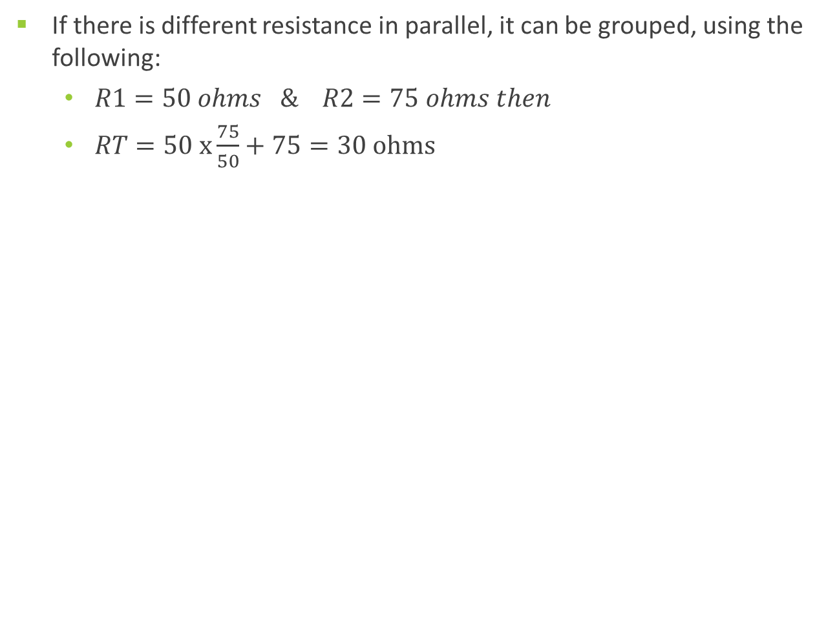
Parallel Circuits (continued)
If there is different resistance in parallel, it can be grouped, using the following:
  $R1=50 ohms \& R2=75 ohms then$
  $RT=50 x\frac{75}{50}+75=30 ohms$
Northeast Iowa Community College [CC BY 4.0]

Slide 20
Series-Parallel Circuits
Combines both series and parallel configurations
Steps involved in solving circuits:
    First, determine the different series and parallel parts.
    Break down the parallel circuits to a single resistance.
    Redraw the circuit as a series circuit (critical step).
    Calculate total resistance.
    Calculate current if voltage
    is known.
    Calculate voltage if current
    is known.
Northeast Iowa Community College [CC BY 4.0]

Slide 21
Conclusions
Upon completion of this unit, students should be able to
Protons and neutrons do not move from atom to atom.
Current is the movement of electrons from one atom to another.
Insulators inhibit the flow of electrons while conductors allow for free flow of electrons. Semi- conductors are somewhere in the middle and will become critical in PV cell design.
Photons are energy particles from the sun used in the production of electricity in a PV module.
Voltage, current, and resistance are all related and used in circuit calculations by incorporating ohms law.
Energy consumed will be expressed in watt-hours, which is a calculation to use in determining a PV system and its requirements.
An electrical circuit has four requirements, including switch, load, power supply and conductors.
Any circuit contains only two different items: a switch to pass power or a load to consume power.
Circuits can be series, parallel, or series-parallel. Formulas exist to determine amounts.
When working with formulas, the answer is wrong if units are not identified.
“This presentation was prepared by Northeast Iowa Community College under award EG-17-004 from the Iowa Energy Center. Any opinions, findings, and conclusions or recommendations expressed in this material are those of the author(s) and do not necessarily reflect the views of the Iowa Energy Center.”

