Slide 1

Residential Wind
Introduction to Residential Wind Energy
Except where otherwise noted these materials are licensed Creative Commons Attribution 4.0 (CC BY)

Slide 2
Objectives
The objective of this unit is to present the student with some basic terms relating to energy, efficiency, and conservation. Upon completion, the student will have an understanding of the following:
Electrical Generation
Average wind speed
Power in the wind
HAWT vs VAWT
Furling

Slide 3
Measuring the wind
We need to determine if the site is good for wind generation.
Wind turbines need to be at least 30’ above any obstacle within 300’.
If installing one locally, check regulations.
The cheapest way to increase power is to increase tower height.
Measuring the wind
We need to calculate the average over time as opposed looking at a specific time.
There is a big difference between 10mph and 12mph.
A typical 10’ diameter (blades) turbine can make 75-100kwh/month and an average wind speed of 10mph. The same turbine at 12mph can generate 125-150kwh/month.
We want to utilize the average wind speed when deciding if practical.
One needs to calculate hours per year at the average wind speed.

Slide 4
Average Wind Speed
National Renewable Energy Laboratory [Public domain]. Retrieved from https://www.nrel.gov/gis/wind.html

Slide 5
Commonalities of Renewable Systems
All renewable systems have three elements in common:
Energy sources: Devices that generate electricity, such as photovoltaic panels, wind turbines, hydro plants, etc.
Energy Storage: A way to store energy for use when there is none coming in.
Loads: All the lights, appliances, and any other loads in a home
Renewable systems can be classified into three different types:
Off-grid: The system is not connected to the electrical grid. Excess can be stored in batteries.
Grid-tied: The system is directly tied to the grid, and the excess is put into the grid, which acts like a battery.
Grid-tied battery backup: The system is connected to the grid, and batteries are used in case the grid goes out.

Slide 6
Power in the Wind
A wind turbine extracts energy from the moving air by slowing the air down and transferring the harvested energy into a spinning shaft, which then turns a generator.
Kinetic energy from the wind
Mechanical energy from the shaft and bearings
Electrical energy from the generator
* Note, any loss in energy will show up in heat.
The power in the wind that’s available for harvest depends on:
Wind speed
Air density
Area swept by turbine blades
*The power in the wind is the cube of the air speed.

Slide 7
Key Terms
Work
Work is defined as a force acting over distance and is measured in joules. One joule equals a force of one newton acting over a distance of one meter.
Energy
The term energy can be used to describe how much work was done (kinetic) or how much work could be done (potential).
Power
The rate at which work was or can be performed
Wind turbines, in a roundabout way, gather solar energy.
The sun heats the earth causing convective currents.
Thermal energy from the sun is transferred to the atmosphere giving it kinetic energy.

Slide 8
Efficiency losses
Many factors will reduce the efficiency of a turbine that needs to be taken into consideration.
Betz Limit states that 59.26% is the absolute maximum that can be extracted from the available power in the wind.
Friction losses due to bearing friction or any other friction ends up as a heat loss.
There are both electrical and magnetic losses with wind turbine generators when converting that power in the spinning shaft into electricity.
Coefficient of power is another term for efficiency. Less efficient turbines would need more blade sweep to make the same power as more efficient turbines.

Slide 9
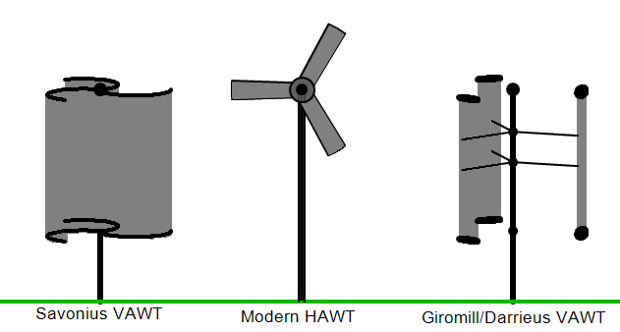
HAWT vs VAWT
HAWT (Horizontal axis wind turbine)
The blades spin on an axis parallel to the ground, and the entire machine pivots (yaws) around to face the wind.
VAWT (Vertical axis wind turbine)
The blades spin on an axis perpendicular to the ground; VAWT’s don’t need to yaw into the wind.
Ssgxnh [Public domain]. Retrieved from https://commons.wikimedia.org/wiki/File:HAWT_and_VAWTs_in_operation_medium.gif

Slide 10
Yaw and Furl
The terms yaw and furl describe how turbines rotate to face into the wind or out of the wind.
Yaw: In wind turbine systems, yaw is the rotation of the entire wind turbine around the axis of the tower.
Furl: In wind turbine systems, furling is when the turbine either
Yaws to point away from the wind direction
Or
Tilts back vertically
Both serve to reduce the sweep area of the blades and protect the turbine from high winds.

Slide 11
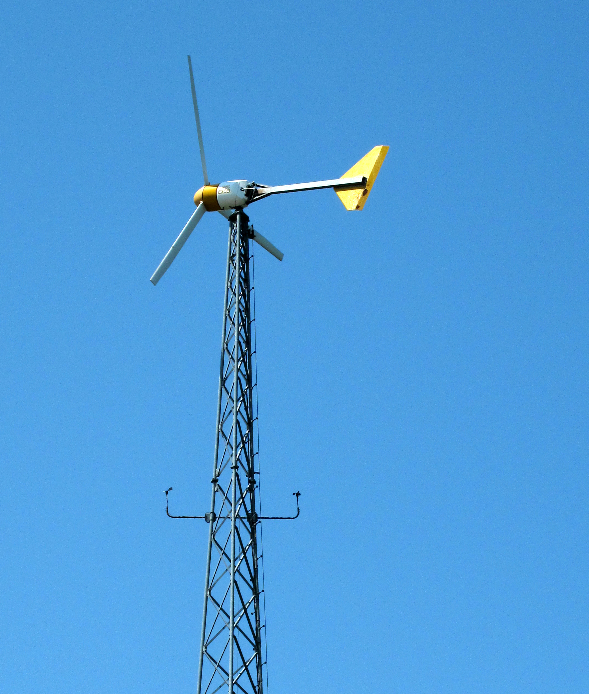
Furling Tail
The furling tail yaws the turbine to the side when winds get too high.
Reduces sweep area
The tail is the only moving part.
When the tail folds, the entire generator will yaw and follow it.
Tail vane is parallel to wind direction.
S. Richard [CC BY NC 2.0]. Retrieved from https://www.flickr.com/photos/9428166@N03/3817158899/

Slide 12
Electrical Controls
Inverters
A control that converts low power DC to 120VAC for powering house loads
System metering
Meters are available that count amp-hours and or watt-hours directly for the entire system by constantly measuring what is coming in and out.
Controllers
Batteries can be damaged by overcharging, and protection of them is required.
Wind systems will create a dump load that will utilize any extra power to help prevent damage.

Slide 13
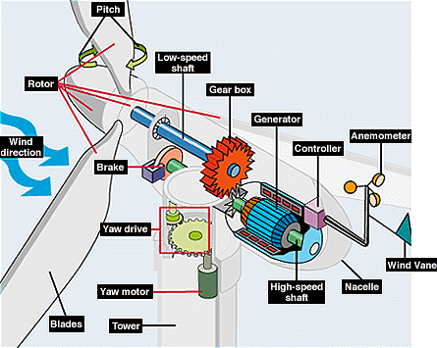
Turbine Schematic
Office of Energy Efficiency and Renewable Energy [Public domain]. Retrieved from https://commons.wikimedia.org/wiki/File:EERE_illust_large_turbine.gif

Slide 14
Conclusions
Upon completion of this unit, students should be able to
Discuss average wind speed
Describe a furling tail
Discuss power in the wind
List the basic control in a system
Discuss residential turbine construction
“This presentation was prepared by Northeast Iowa Community College under award EG-17-004 from the Iowa Energy Center. Any opinions, findings, and conclusions or recommendations expressed in this material are those of the author(s) and do not necessarily reflect the views of the Iowa Energy Center.”

