Slide 1

Geothermal Systems
The Refrigeration and heat pump Cycle utilized with Geothermal
Except where otherwise noted these materials
are licensed Creative Commons Attribution 4.0 (CC BY)

Slide 2
Objectives
The objective of this unit is to present the student with basic geothermal terms and the refrigeration cycle/heat pump cycle used in geothermal. Upon completion, the student will have an understanding of the following:
Basic geothermal terminology
The basic layout of different loop configurations
Latent and sensible heat
The refrigeration cycle and heat transfer pump cycle (see above)
Refrigeration components
The purpose of the reversing valve

Slide 3
Geothermal
Basics
The concept of geothermal utilizes the earth’s crust as the medium for transferring energy.
One of the most sustainable sources of alternative energy
Does not contribute to global warming
A form of renewable source that is independent of the sun, the ultimate source of geothermal energy comes from within the earth.
The earth functions as a massive thermal “battery.”
A geothermal heat source is a substance that is used to supply energy, and a heat sink is a substance to reject heat.
  The ground has the ability to be used as a heat source and a heat sink.
  Soil composition and moisture content influence the thermal conductivity.

Slide 4
Geothermal
Basics
A geothermal heat pump moves the Btu’s for heating and cooling rather than creates new Btu’s.
  By doing this, the source energy needed to operate a geothermal system is significantly less compared to a normal gas furnace or electricity for an air conditioner.
  Some geothermal systems include a desuperheater, which is an auxiliary heat exchanger to help pre-heat DHW.
  Some estimates by the US. Department of Energy indicate that the average geothermal system can provide 60% of an average home’s hot water.
The transfer of energy is made possible by tubes buried 5 feet below the surface or in a pond. (Closed Loop)
An open loop system is where water is taken from the water table and put back into the water table after transferring heat.

Slide 5
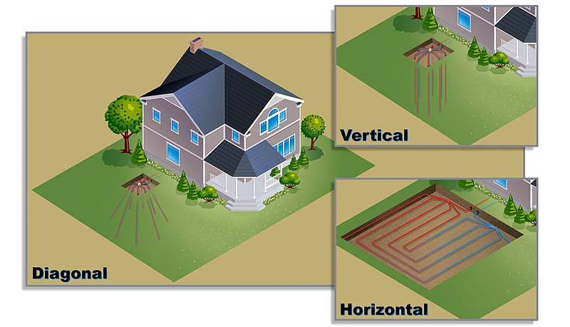
Geothermal Loop Configurations
WGisol. [CC-BY 4.0]. Retrieved from https://en.wikipedia.org/wiki/File:ETI-FS_Loop_Diagrams,_01.26.11.jpg

Slide 6
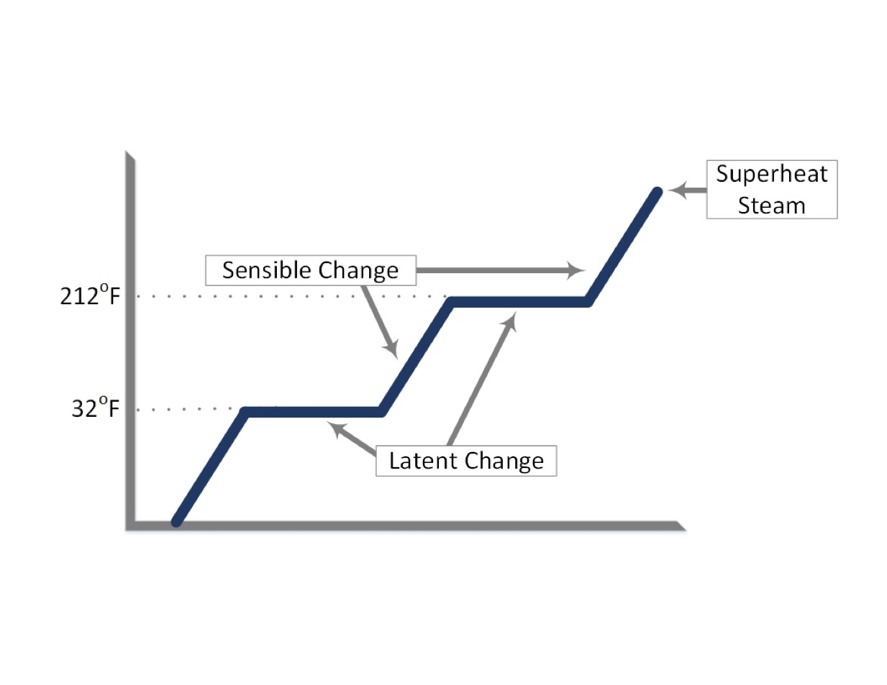
Sensible and Latent Changes
The BTU’s in a geothermal system are moved by the refrigeration system.
Sensible Heat: Heat that can be felt
Latent Heat: Hidden heat or a change of state
Northeast Iowa Community College. [CC-BY 4.0].

Slide 7
Basic Refrigeration Cycle
The purpose of the air conditioning cycle is to take heat where it is not wanted and move it to a place where it is unobjectionable.
  In the summer, we remove heat from the house and put it in the ground.
  In the winter, we remove heat from the ground and put it in the house.
The units contain refrigerants.
  The refrigerant will absorb heat by evaporation.
  The refrigerant will release heat by condensation.
The geothermal system utilizes a heat pump, which is the same as that used in an air conditioner but can change the direction of refrigerant flow.

Slide 8
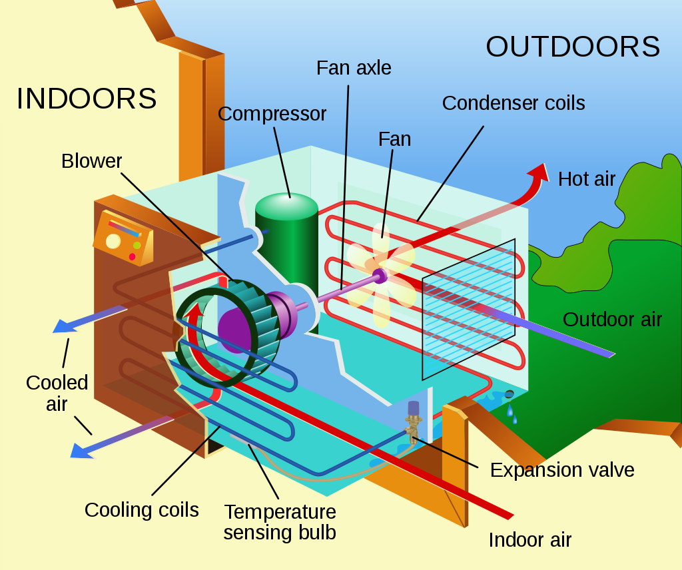
Basic Refrigeration
Components
Compressor: The compressor is a vapor pump that will take low -pressure, superheated vapor and compress it to a high-pressure superheated vapor.
Condenser: The condenser releases heat by the condensation of the superheated refrigerant. Both sensible and latent changes occur in the condenser.
Metering Device: The metering device takes high-pressure, high temperature liquid and reduces it to low-pressure, low-temperature liquid. This device controls the boiling point of the refrigerant.
Evaporator: The evaporator will take low-pressure, low-temperature liquid refrigerant and absorb heat, causing the liquid to turn to a vapor.
Pbroks13 [CC BY 3.0]. Retrieved from https://commons.wikimedia.org/wiki/File:Air_conditioning_unit-en.svg

Slide 9
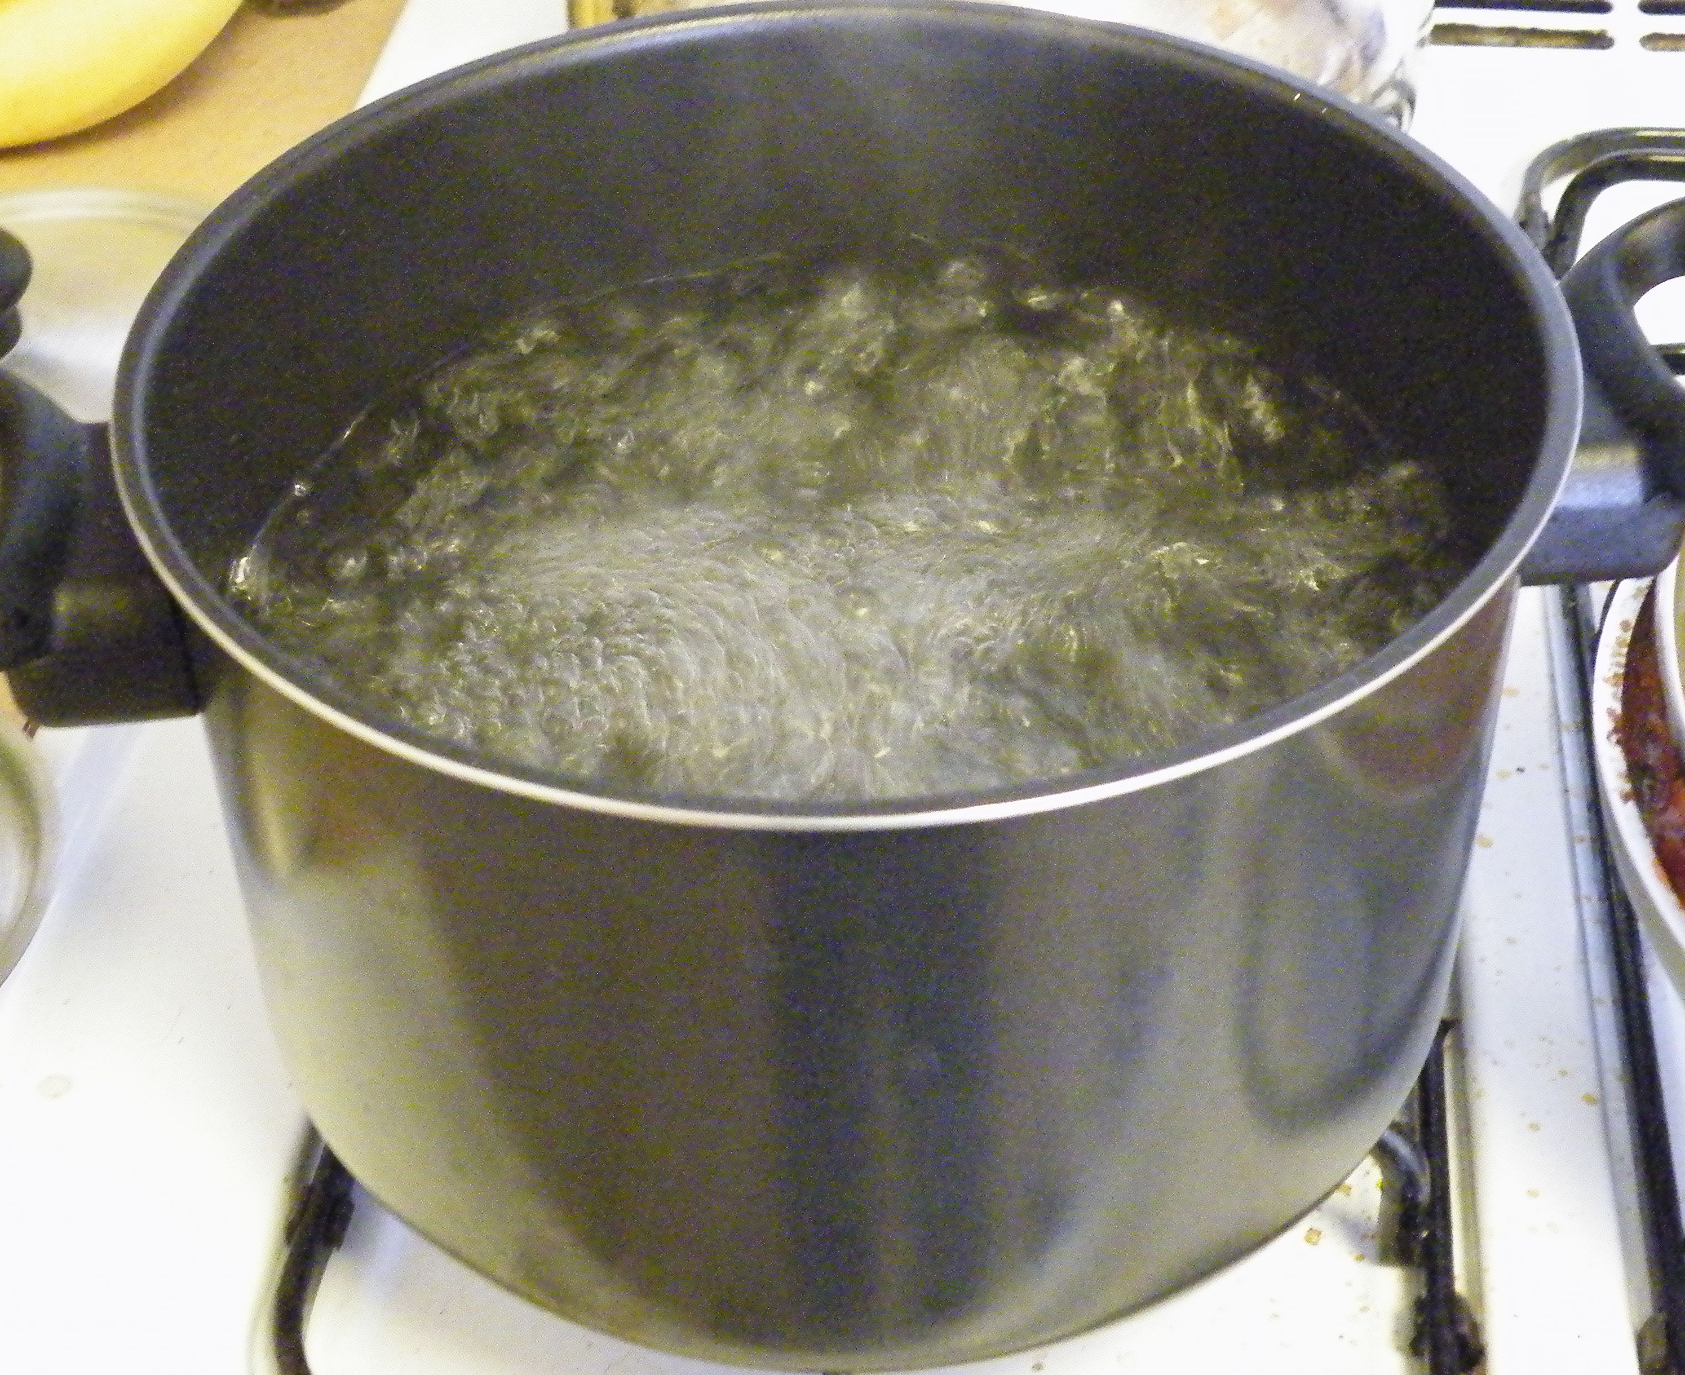
Absorbing Heat and Releasing Heat
GRAN [CC BY 3.0]. Retrieved from https://commons.wikimedia.org/wiki/File:Boiling_water.jpg
Northeast Iowa Community College [Public Domain]

Slide 10
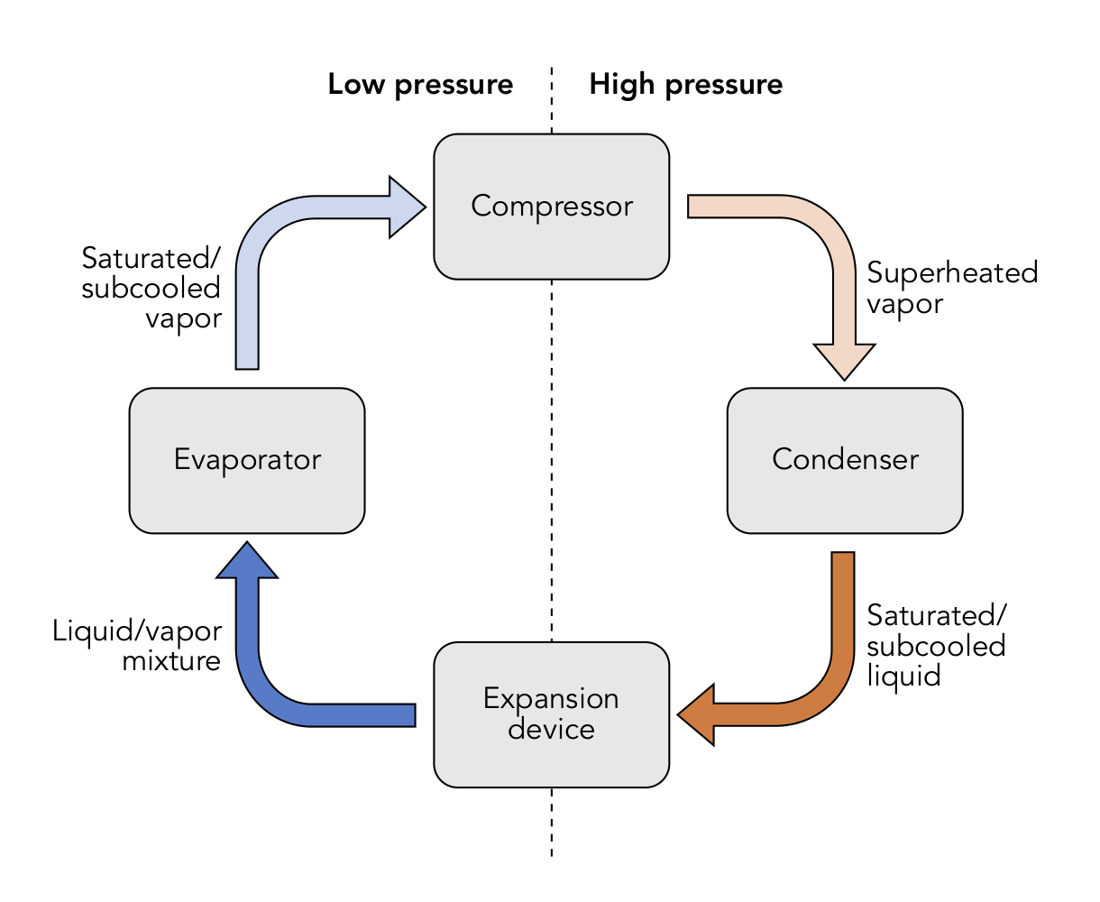
Basic Refrigeration Cycle
Wgisol. [CC BY-SA 4.0]. Retrieved from https://commons.wikimedia.org/w/index.php?curid=53596458

Slide 11
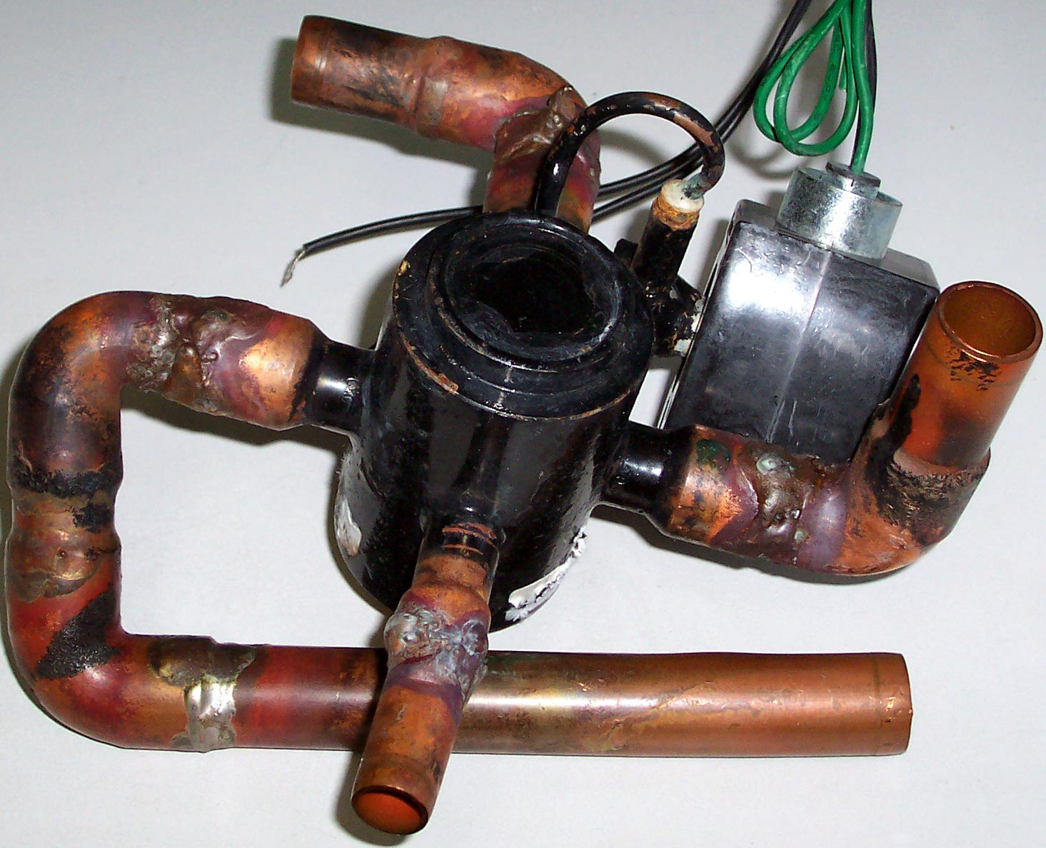
Reversing Valve
The reversing valve is the component added to the normal air conditioning unit to reverse the flow of refrigerant in a system.
The valve will be set up fail-safe.
W4kda [CC BY 3.0]. Retrieved from https://commons.wikimedia.org/wiki/File:ReversingValve-1465x1440.jpg

Slide 12
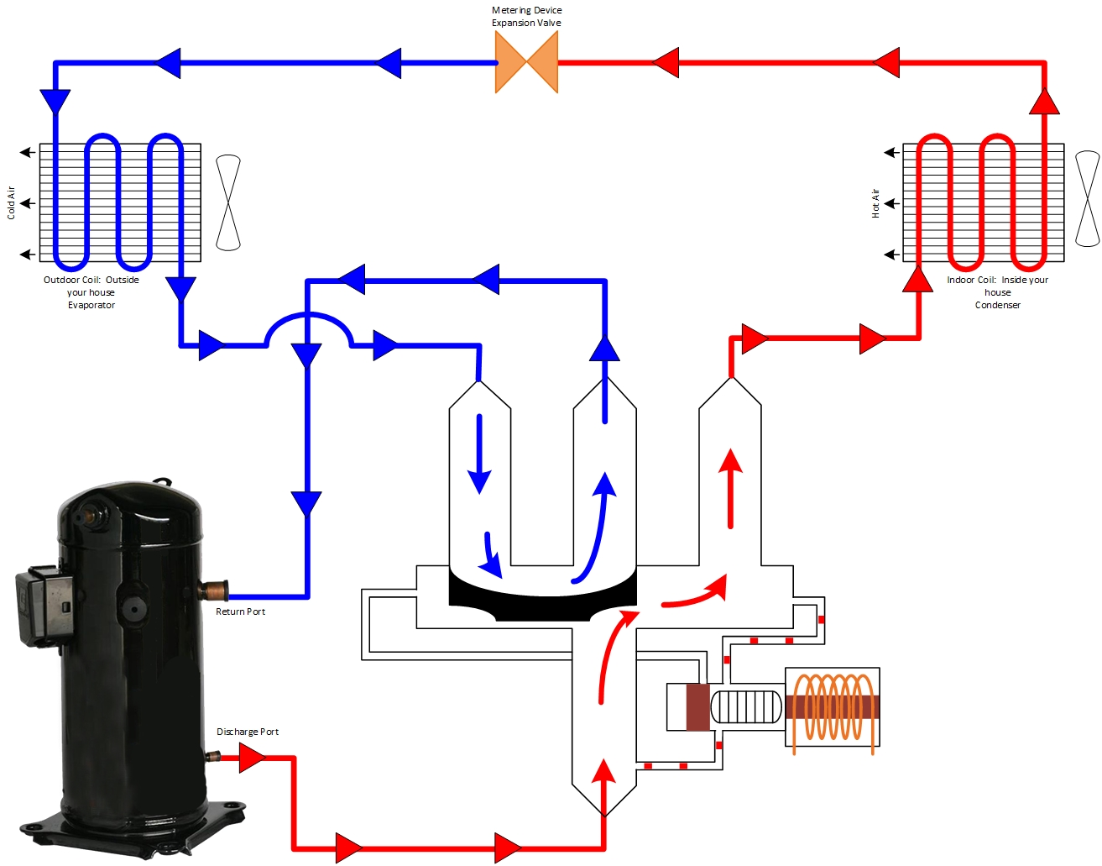
Heating mode
Northeast Iowa Community College [Pubic domain].

Slide 13
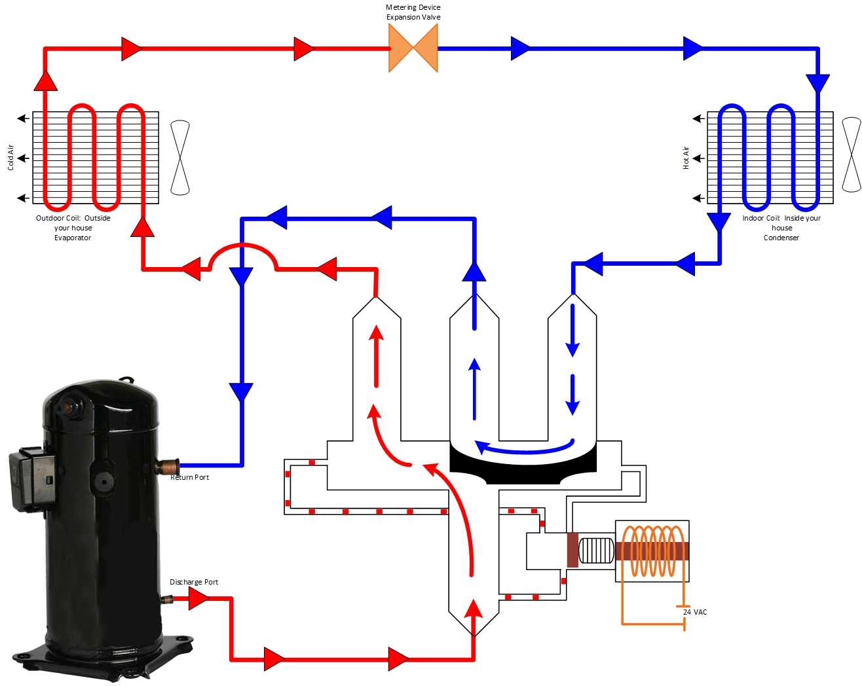
Cooling
Mode
Northeast Iowa Community College [Public Domain]

Slide 14
Conclusions
Upon completion of this unit, students should be able to
Define the meaning of basic geothermal terms
Define the components of the refrigeration cycle
Explain the refrigeration cycle and the movement of energy
Explain the purpose of the reversing valve
Explain the operation of the heat pump in the summer and winter modes
“This presentation was prepared by Northeast Iowa Community College under award EG-17-004 from the Iowa Energy Center. Any opinions, findings, and conclusions or recommendations expressed in this material are those of the author(s) and do not necessarily reflect the views of the Iowa Energy Center.”

