Slide 1

Solar photovoltaics
Stand alone vs. interconnected
Except where otherwise noted these materials are licensed Creative Commons Attribution 4.0 (CC BY)

Slide 2
Objectives
The objective of this unit is to present the student with some basic terms relating to solar PV and applications. Upon completion, the student will have an understanding of the following:
Grid-tied vs off-grid
Electrical grid
Basic components
The balance of system components

Slide 3
Stand alone vs. interconnected
Stand-alone system
Not connected to any other systems
Can use a variety of energy types including solar or propane
Also called an Off-Grid System, Battery Base System or a Remote Area Power Supply
Interconnected System
Attached to other systems
Supplies power to more than one structure
Can utilize a variety of energy types, including hydro electrical, nuclear or solar
Also called Grid Tied, Grid Connected, Utility Interactive Systems, Line Commutated or Grid Direct System
Other names for Interconnected solar system
Grid Tied
Grid connected
Utility Interactive Systems
Line commutated
Grid direct system
Notes:
.

Slide 4
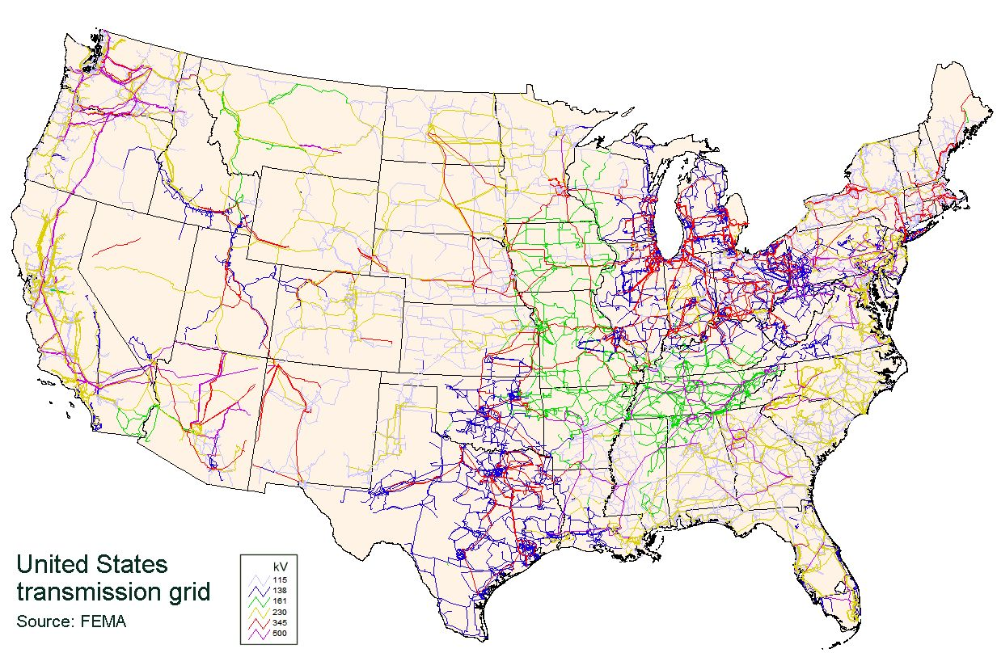
Electrical grid
An electrical grid is an interconnected network for delivering AC electricity from producers to consumers.
It consists of generating stations that produce electrical power and high-voltage transmission lines carrying power from distant sources to demand centers, and distribution lines connecting individual customers.
J Jmesserly. 2008. [Public Domain]. Retrieved from https://commons.wikimedia.org/wiki/File:UnitedStatesPowerGrid.jpg

Slide 5
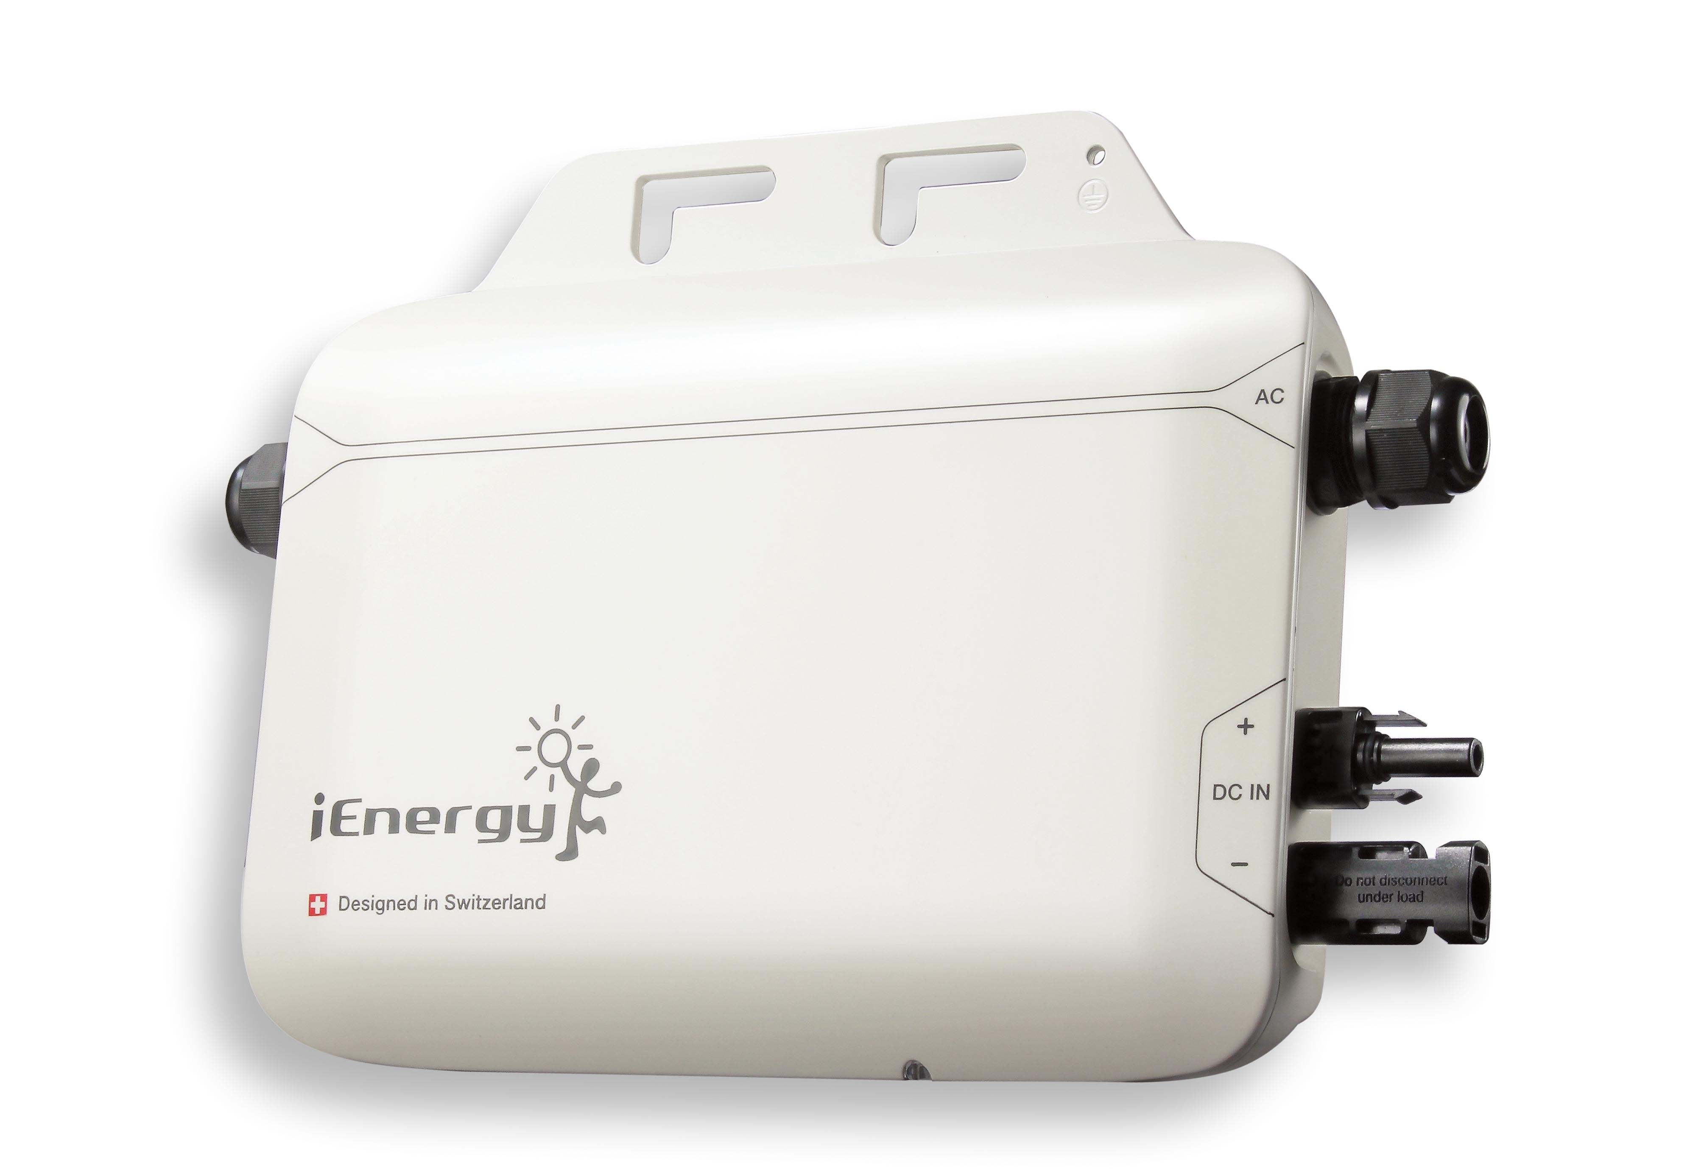
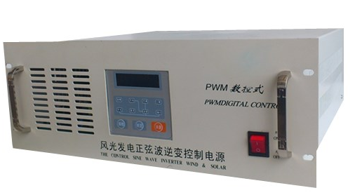
Inverter
An inverter changes DC (direct current) from a Solar array and/or batteries into AC (Alternating current) that can be used convectional AC loads.
Interactive and stand-alone inverters are NOT interchangeable and should never be used on the opposite system.
steven huang [Public domain]. Retrieved from https://commons.wikimedia.org/wiki/File:Microinverter.jpg
Senlin Yang [CC BY-SA 3.0]. Retrieved from https://commons.wikimedia.org/wiki/File:2KW_wind%26solar_hybrid_controller_with_inverter.jpg

Slide 6
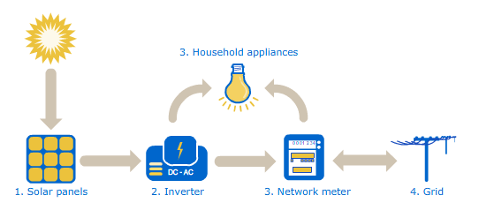
Interconnected
An interconnected PV system is connected directly to the utility grid and uses it as an energy storage bank.
When more electricity is made than the house uses, a special meter (net meter) will turn backwards and use the grid like a battery.
This is the most common system installed.
The interconnected inverter will shut down if the utility is down and will not produce electricity. It’s the law. This prevents workers from getting shocked.
AGL Solar Energy [CC BY 3.0]. Retrieved from https://commons.wikimedia.org/wiki/File:How_Solar_Power_Works.png

Slide 7
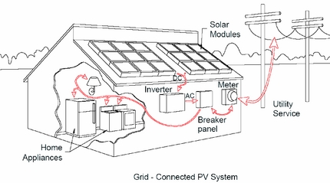
Interconnected Sizing
Generally dependent on the monthly or yearly electrical bill of the household or business
Grid tied system
Size depends on the available unshaded space to put the system and/or the amount of money available for the system purchase.
U.S Securities and Exchange Commission [Public Domain]. Retrieved from https://www.sec.gov/Archives/edgar/data/1347452/000095013606006805/file1.htm

Slide 8
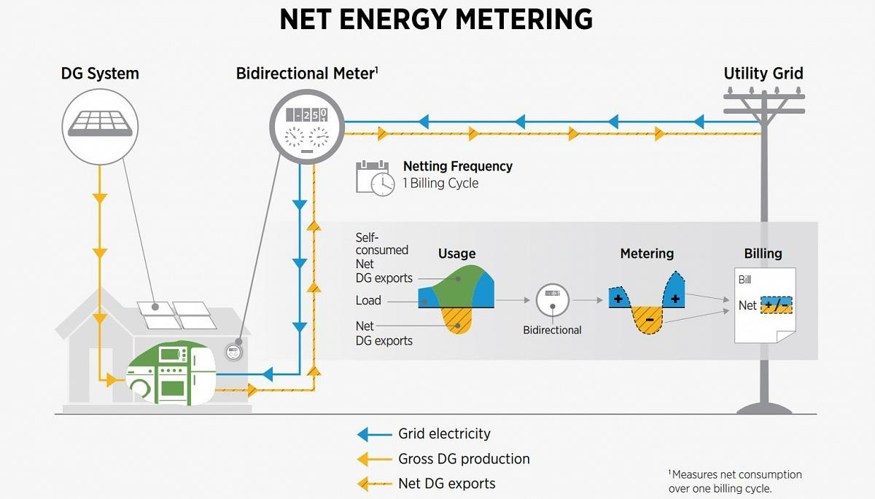
Interconnection agreement
An interconnection agreement is the policy and electrical standards for connecting a PV system to the grid.
Utility agreements vary greatly from utility to utility and from state to state.
National Renewable Energy Laboratory [Public domain]. Retrieved from https://www.nrel.gov/state-local-tribal/blog/posts/back-to-basics-unraveling-how-distributed-generation-is-compensated-and-why-its-important.html

Slide 9
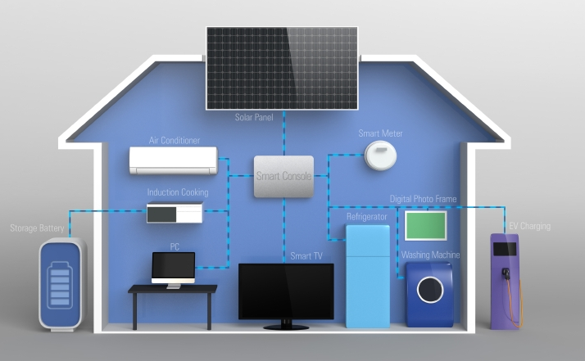
Stand alone
They operate off-grid that are not connected to utility grid in any way.
These systems can be stationary or mobile.
The stand-alone needs batteries or energy storage to continue to run a load at night or on cloudy days.
U.S. Department of Energy [Public domain]. Retrieved from https://www.energy.gov/energysaver/balance-system-equipment-required-renewable-energy-systems

Slide 10
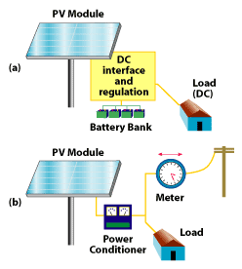
Balance of system (BOS)
The Balance of System (BOS) encompasses all components of a photovoltaic system other than the photovoltaic panels.
Includes wiring, switches, a mounting system, one or many solar inverters, a battery bank and battery charger
U.S. Department of Energy [Public domain]. Retrieved from https://web.archive.org/web/20080504001534/http://www1.eere.energy.gov/solar/bos.html

Slide 11
Grid Tied System vs Standalone Advantages vs. Disadvantages
Grid Tied System | Standalone
Advantages
Do not have to meet full loads needs | Electrical freedom
No batteries | Operates in power outage
Disadvantages
No power provided if grid goes down | Batteries are dangerous and require maintenance.
Interconnection | Must meet full loads needs. So, it’s difficult to size.
 | Expensive for large loads
 | Low voltages require large wires.

Slide 12
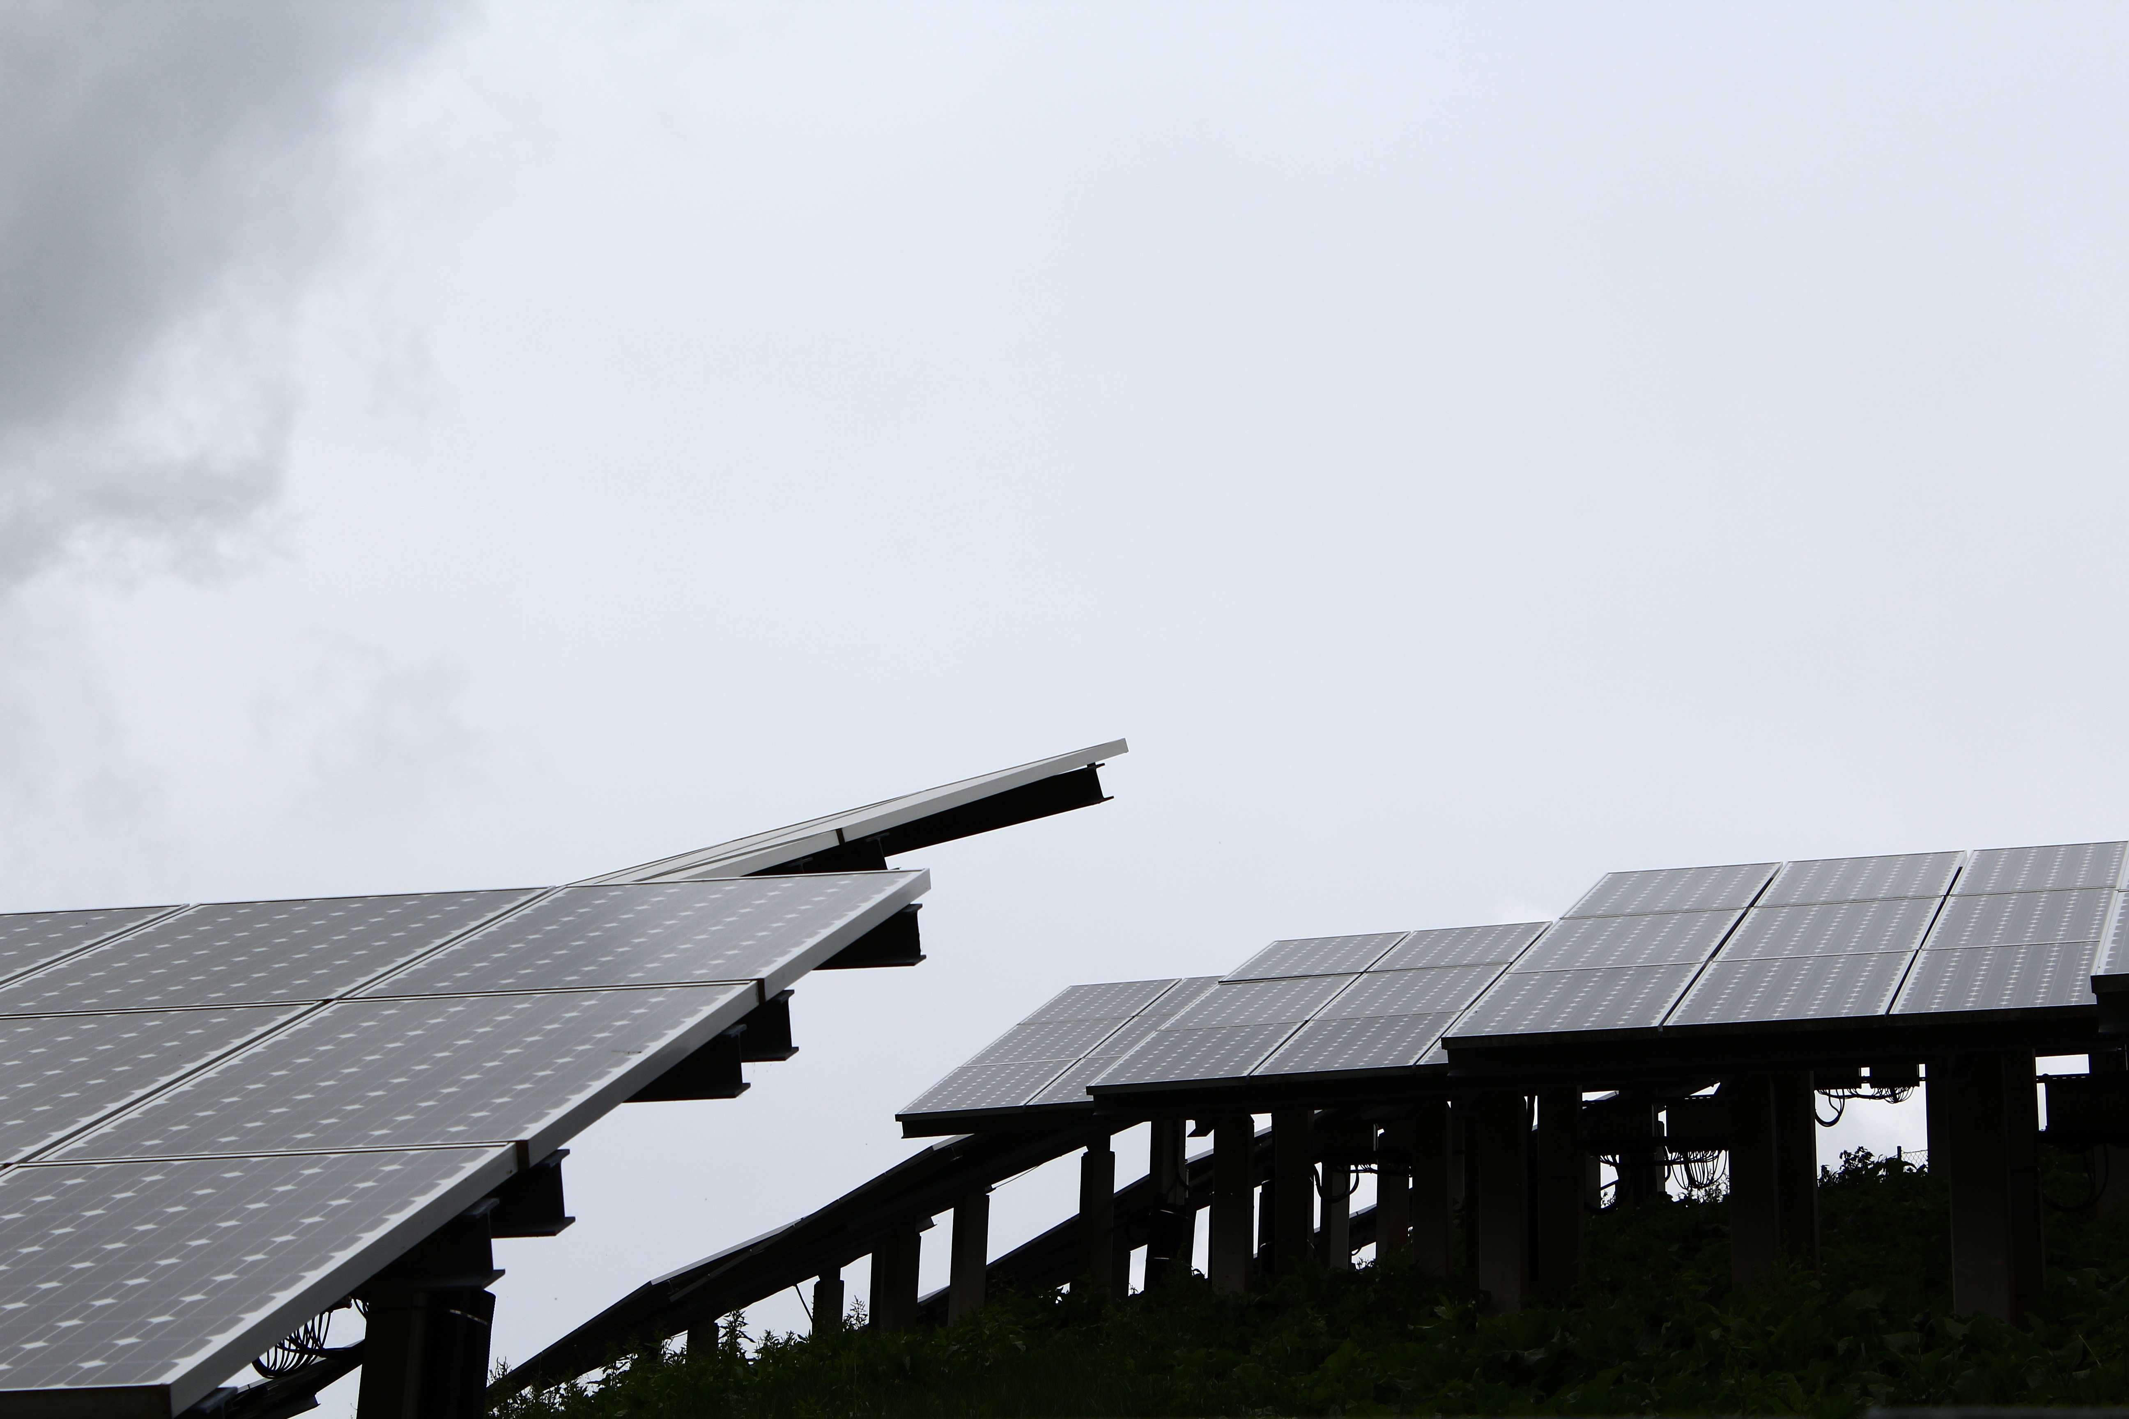
Days of autonomy
Days of autonomy is the number of consecutive days a battery bank can produce electricity without sun.
Retrieved from https://pxhere.com/en/photo/730708

Slide 13
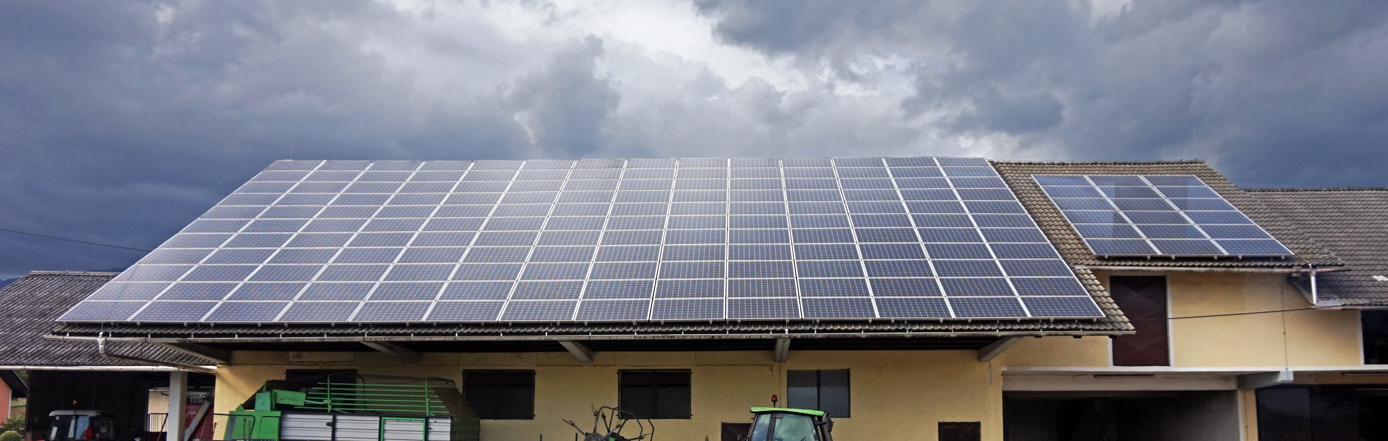
Days of autonomy
Tiia Monto [CC BY-SA 3.0]. Retrieved from https://commons.wikimedia.org/wiki/File:Solar_panels_in_%C4%8Ce%C5%A1njevek.jpg
Unfortunately, the sun does not shine every single day.
When there are several cloudy days in a row, it may be hard for the solar module to give the batteries a full charge.
Days of Autonomy is the number of consecutive days a battery bank can provide energy to a load without available solar to recharge the bank.

Slide 14
Conclusion
Upon completion of this unit, students should be able to
Define stand-alone systems
Define grid tied systems
Explain an electrical load
Explain autonomy
Explain an interconnection agreement
Discuss different components used
“This presentation was prepared by Northeast Iowa Community College under award EG-17-004 from the Iowa Energy Center. Any opinions, findings, and conclusions or recommendations expressed in this material are those of the author(s) and do not necessarily reflect the views of the Iowa Energy Center.”

