Slide 1

Basic Renewable Energy
Introduction to common terminology
Except where otherwise noted these materials
are licensed Creative Commons Attribution 4.0 (CC BY)

Slide 2
Objectives
This presentation provides entry level curriculum and explanations for the student to gain an understanding of Renewable Energies and its fundamentals.
The goal is for students to understand the following outcomes:
  Renewables vs. Non-Renewables
  Direct and Indirect Uses
  Understand basic terminology for renewable energy
  Gain a core level knowledge of different forms of renewable energy
  Generates interest

Slide 3
Introduction
As a country, we rely on fossil fuels for energy needs:
  Coal
  Oil
  Natural gas
We also rely on some nuclear for energy:
  Cost
  Safety
  Disposal of Waste

Slide 4
Renewable vs. Non-Renewable Energy
Renewable
Constantly replenished
Does not have significant pollutant emissions
Renewables cost money so you must weigh benefits.
Solar
Non-renewable
Draws on finite sources which will eventually run out
Pollutants are of concern (greenhouse gases).
Fossil Fuels such as coal, oil, natural gas
VS.

Slide 5
Defining Renewable Energy
Energy obtained from continuous or repetitive currents of energy recurring in the natural environment (Twidell and Weir, 1986).
Or
Energy flows which are replenished at the same rate they are used (Sorensen, 2000).
Or
Renewable energy is energy that is collected from renewable sources, which are naturally replenished on a human timescale, such as sunlight, wind, rain, tides, waves, and geothermal heat. Renewable energy often provides energy in five important areas: electricity generation, air and water, heating/cooling, transportation, and rural (off-grid) energy services (Wikipedia, 2017).

Slide 6
Uses of Renewable Energy
Direct uses
  Direct: Converted directly into useful energy
    Absorbed in solar collectors providing space heating or hot water
    Concentrated by mirrors to provide high heat for electrical production
    Converted directly into electricity using PV module
Indirect uses
  Converted into useful energy indirectly through other energy forms
    Hydropower: Energy extracted from dams and turbines
    Wind: Energy extracted from air movement
    Wave: Wind moving over long stretches of the ocean creating waves
    Bioenergy: Through photosynthesis in plants
Non Solar Renewables
  These are renewable, not depending on solar radiation.
    Tidal: This is not wave energy; the power of tides is harnessed.
    Geothermal: Heat from within the earth

Slide 7
Geothermal
One of the most sustainable sources of alternative energy
Geothermal does not contribute to global warming.
The earth’s crust is the medium for transferring energy in the concept of geothermal.
A form of renewable source that is independent of the sun. The ultimate source of geothermal energy comes from within the earth.
Enthalpy: Amount of heat content in a substance. In studying geothermal, recognize that temperature and enthalpy go hand- in-hand.

Slide 8
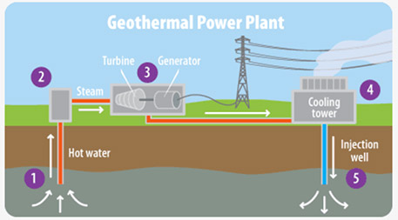
Geothermal - How it works
Hot water is brought to the surface.
Water changes to steam.
It is then sent to a turbine to turn a generator which will generate a voltage for consumption.
Energy is extracted in the process and returned to the cooling tower.
Additional heat is removed from water, and it is injected back in the well.
EPA. 2016. A Student’s Guide to Climate Change.[Public Domain] Retrieved from https://www3.epa.gov/climatechange//kids/solutions/technologies/geothermal.html

Slide 9
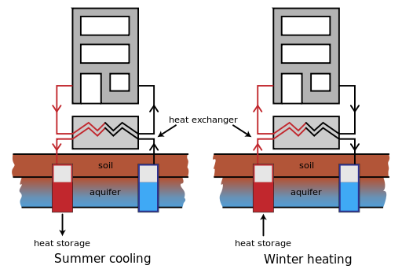
Geothermal: summer vs. winter
In the summer, you are moving warm air from the house putting it in the ground, and creating cooler air in the house.
HeatAndColdStorageWithHeatPump.jpg: KVDPderivative work: Fred the Oyster [CC BY-SA 3.0] https://commons.wikimedia.org/wiki/File:HeatAndColdStorageWithHeatPump.svg
In the winter, you are taking the cool air from the house and bringing in heat from the ground.

Slide 10
Solar Thermal
Solar thermal could be used in any area.
Works more efficiently in some areas
Depends upon insolation, which is the amount of electromagnetic energy that, in the form of solar radiation, hits the surface of the earth. In other words, the available sunshine hitting the earth.
NREL (National Renewable Energy Laboratory of the United States Department of Energy) [Public domain]. Retrieved from https://commons.wikimedia.org/wiki/File:NREL_USA_PV_map_hi-res_2008.jpg

Slide 11
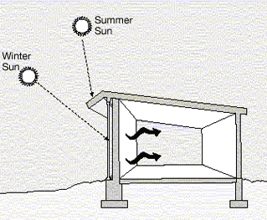
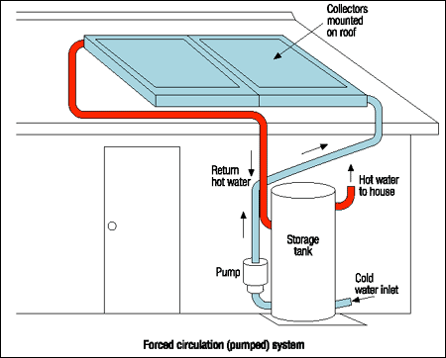
Two basic systems
  Passive: Utilizes energy from sun without the use of electrical or mechanical devices
Uploaded by User:Leonard G. from US DOE site http://www.eere.energy.gov/de/passive_solar_design.html, [Public domain]. Retrieved from https://commons.wikimedia.org/wiki/File:Illust_passive_solar_d2_319pxW.gif
Active: Utilizes energy from the sun and relies on mechanical and electrical means to transfer heat
Western Australia [public domain]. Retrieved from https://commons.wikimedia.org/wiki/File:Active_open_loop_solar_HW_system.png

Slide 12
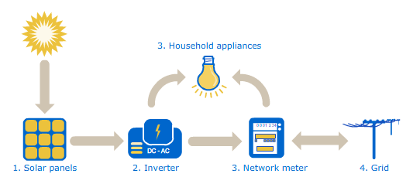
Solar Photovoltaics (PV)
Process of converting solar energy from the sun into electrical energy
On a clear day, the amount of sunlight striking a square meter of earth is approximately equal to 1000 Watts.
It does depend on location and time of day.
There are no moving parts, so it can operate for an indefinite amount of time without wearing out.
The output of
electricity is the
most useful form
of energy.
PV cells produce
DC, not AC.
AGL Solar Energy [CC BY 3.0]. Retrieved from https://commons.wikimedia.org/wiki/File:How_Solar_Power_Works.png

Slide 13
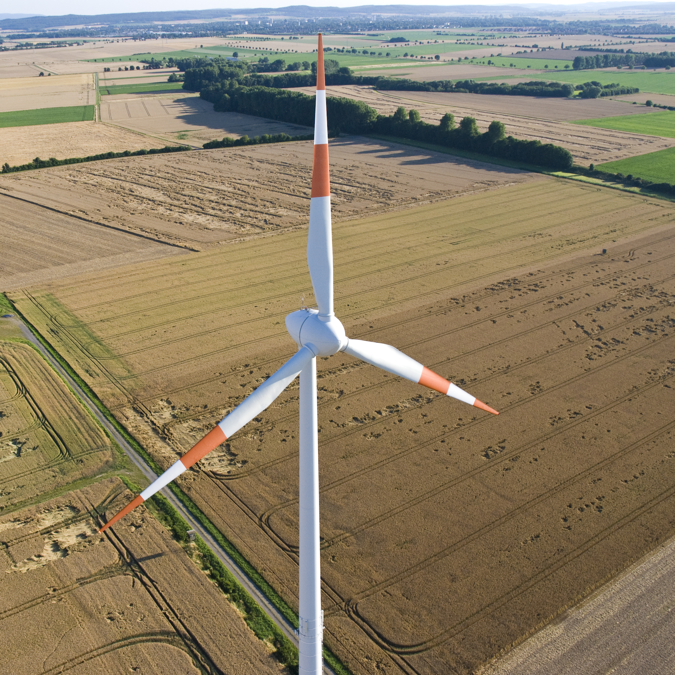
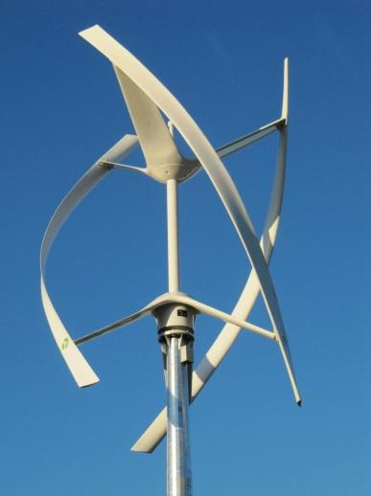
Wind Energy
Kinetic energy from the wind is turned into mechanical energy, which is turned into electrical energy.
Air is the fluid that makes a turbine turn.
Wind is created by the uneven heating of the earth’s surface, so it could be considered a solar energy source.
Average wind speed over a year’s time is the critical factor in wind energy.
Betz limit defines maximum output of a turbine.
Blades utilize an air foil design for lift and drag.
Philip May [CC BY-SA 3.0]. Retrieved from https://commons.wikimedia.org/wiki/File:Windrad-Wind-Turbine.jpg
Maume.B [CC BY-SA 4.0] Retrieved from https://commons.wikimedia.org/wiki/File:Axe-v.jpg

Slide 14
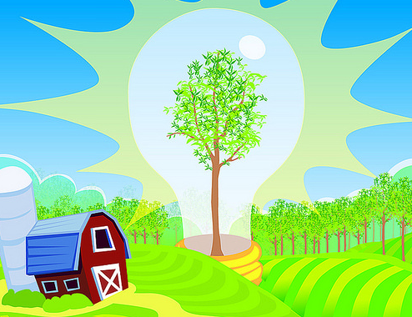
Bioenergy
Bioenergy is the general term for energy derived from materials such as wood, straw, or animal wastes.
Biomass:
  An organic material which has stored sunlight in the form of chemical energy
  One of the largest renewable energy sources in use today
    Raw Biomass
    Secondary Biomass
Biofuels Liquid
  Renewable transport fuels
  Bioethanol, Biodiesel
Solid Biofuels
  Wood, charcoal,
  biomass pellets
Argonne National Laboratory [public domain]. Retrieved from https://www.flickr.com/photos/argonne/19496098602

Slide 15
Conclusions
Upon completion of this unit, students should be able to
We need to reduce our use of fossil fuels for the future.
There are direct and indirect uses of solar.
Non-solar renewables do exist.
Geothermal uses the earth’s temperature to transfer heat.
Solar Thermal uses the sun and can be defined as an active or passive system.
Solar Photovoltaics uses the energy for the sun to generate electricity.
Wind Energy harnesses the kinetic energy from the wind to produce electricity.
Bioenergy is a general term for energy derived from materials.
There are many other forms of renewables that we did not address that need to be explored by YOU.
“This presentation was prepared by Northeast Iowa Community College under award EG-17-004 from the Iowa Energy Center. Any opinions, findings, and conclusions or recommendations expressed in this material are those of the author(s) and do not necessarily reflect the views of the Iowa Energy Center.”

