Slide 1

Electric and Hybrid Vehicles
Warning: Follow Vehicle Manufacture Recommendations As High Voltages Can Harm or Kill You

Slide 2
Safety Equipment- Required
1. Class 0 Insulated Rubber Gloves
2. Safety Glasses
3. CAT III Multimeter 1000 Volt
4. Service Information
5. Scan Tool
6. Safety Cones/ Caution Tape
7. Fire Extinguisher

Slide 3
Safety Equipment- Required, cont.
8. Megger/Insulation Tester Meter
9. High Voltage End Covers/ Black Tape
10. Live Dead Live Tester/ or Battery
11. Insulated Tools
12. Key Lock Box (Not Required)
13. Insulated Boots (Not Required)
14. Technician Release Tool (Not Required)

Slide 4
Class 0 Rubber Gloves/Lineman's Gloves
https://www.salisburyshop.com/salisbury-electrical-gloves-overview
2 pairs recommended
https://www.skarshaug.com/

Slide 5
Safety Glasses
Electricians are required to wear safety glasses to protect their eyes from potential hazards such as sparks, debris, and electrical arcs!
Safety Shields or Safety Goggles

Slide 6
CAT III Multimeter
CAT III 1000 VOLT Multimeter- with Cat III 1000 VOLT Leads.
Fluke PRV240 Proving Unit
When checking high voltage perform LIVE, DEAD, LIVE TEST!
Set meter on stand and use only one hand!
Oscilloscope Testing use with CAT III differential probe!

Slide 7
Service Information
https://www.oem1stop.com/
Factory Service Repair information is highly recommended!
Aftermarket Information- Shop-Key, Mitchell, Chilton, Identifix
Good Time not to listen or watch YouTube videos!

Slide 8
Scan Tool
Factory Scan Tools are Recommended!
Snap-on, Mac Tools, Bosch, Matco, Autoenginuity and Many Others
Bidirectional-Controls is a must!
Mongoose Cables with laptop and factory subscription.

Slide 9
Safety Cones/Caution Tape
Work area needs to be coned and caution taped off!
Battery should only be paced on nonconductive (wood) bench if removed!

Slide 10
Fire Extinguisher
A, B, C Fire Extinguisher – general fires and NiMH Batteries
Type D Fire Extinguisher, or Sand for Lithium based fires or lots of water – will not put fire out!

Slide 11

Megger/Insulation Tester Meter

Slide 12
High Voltage End Covers/Black Tape
Always cover High Voltage cables so they don’t make contact when disconnected
Cover High Voltage Disconnect Openings

Slide 13
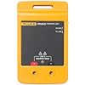
Live Dead Live Tester/ or Battery
Fluke PRV240 Proving Unit-
Provides AC and DC 240-volt test!
Battery was used in past to proof check meter!

Slide 14
Insulated Tools
1/4, 3/8 Ratchets, extensions 8-17 MM Sockets
Phillips (#2) and Flat Bladed Screwdrivers
Pliers, Wire Cutters, Needle Nose Pliers

Slide 15
Key Lock Box (Not Required)
Place to put keys/key fob away from vehicle
After placing key fob away from vehicle, make sure it won’t start or turn on! (possibly second fob)
Lockout Tag Out tag on Master Disconnect is a good idea!

Slide 16
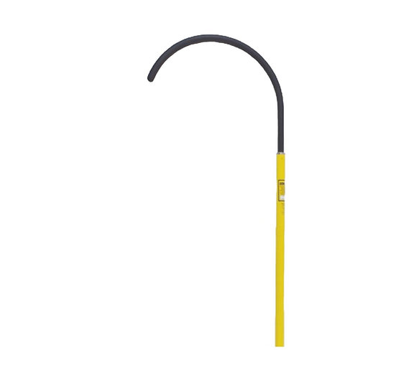
Technician Release Tool (Not Required)
Ford required technicians to have High Voltage Safety Hook or also called Technician Release Tool.

Slide 17
Insulated Boots (Not Required)
Not required but always a good idea when working with electrical!
There are other items you may need or that would be great to have but do your research and read service manuals. Testing and Safety on electric vehicles is always changing so be safe!

Slide 18
Knowledge Check: What Rating Voltmeter is required for testing electric vehicles?
CAT II 600 VOLTS
CAT II 1000 VOLTS
CAT III 600 VOLTS
CAT III 1000 VOLTS

Slide 19
Correct Answer:
CAT II 600 VOLTS
CAT II 1000 VOLTS
CAT III 600 VOLTS
CAT III 1000 VOLTS

Slide 20
Knowledge Check: What is the minimum class glove for working with Hybrids/Electric Vehicles?
Class 00
Class 0
Class 1
Class 2

Slide 21
Correct Answer:
Class 00
Class 0
Class 1
Class 2

Slide 22
Electric/Hybrid Vehicle Components

Slide 23
Major Components
Traction battery pack
DC-DC Converter
Electric motor
Power inverter
Charge Port
Onboard charger
Controller
Auxiliary batteries
Thermal system (cooling)
Transmission

Slide 24
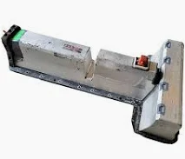
1. Traction Battery Pack
Traction battery pack is also known as Electric vehicle battery (EVB). It powers the electric motors of an electric vehicle. The battery acts as an electrical storage system. It stores energy in the form DC current. The range will be higher with increasing kW of the battery. The life and operation of the battery depends on its design. The lifetime of a traction battery pack is estimated to be 200,000 miles.

Slide 25
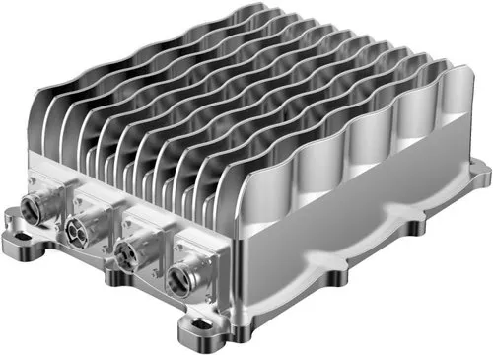
2. DC-DC Converter
The traction battery pack delivers a constant voltage. But different components of electric vehicle has different requirements. The DC-DC convertor distributes the output power that is coming from the battery to a required level. It also provides the voltage required to charge the auxiliary battery.

Slide 26
3. Electric Motor
Electric traction motor is the main components of electric vehicles. The motor converts the electrical energy into kinetic energy. This energy rotates the wheels. Electric motor is the main components of electric vehicle that differentiates an electric car from conventional cars. An important feature of an electric motor is the regenerative braking mechanism. This mechanism slows down the vehicle by converting its kinetic energy into another form and storing it for future use. There are basically two types of motors DC and AC motors.

Slide 27
4. Power Inverter
It coverts DC power from the batteries to AC power. It also converts the AC current generated during regenerative braking into DC current. This is further used to recharge the batteries.

Slide 28
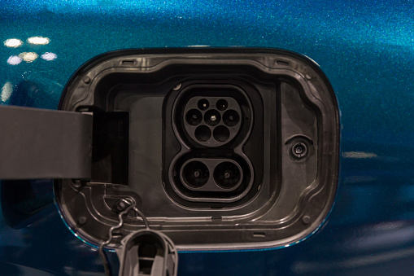
5. Charge Port
Electric Car Charging Port
The charge port connects the electric vehicle to an external supply. It charges the battery pack. The charge port is sometimes located in the front or rear part of electric vehicle components.

Slide 29
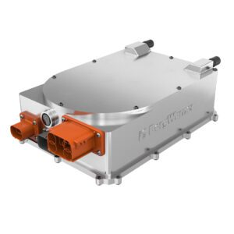
6. Onboard Charger
Onboard charger is used to convert the AC supply received from the charge port to DC supply. The on-board charger is located and installed inside the car. It monitors various battery characteristics and controls the current flowing inside the battery pack.

Slide 30
7. Controller
Power electronics controller determines the working of an electric car. It performs the regulation of electrical energy from the batteries to the electric motors. The pedal set by the driver determines the speed of the car and frequency of variation of voltage that is input to the motor. It also controls the torque produced.

Slide 31
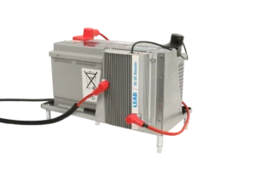
8. Auxiliary Batteries
Auxiliary batteries are the source of electrical energy for the accessories in electric vehicles. In the absence of the main battery, the auxiliary batteries will continue to charge the car. It prevents the voltage drop, produced during engine start, from affecting the electrical system.

Slide 32
9. Thermal System (cooling)
The thermal management system is responsible for maintaining an operating temperature for the main components of electric vehicle (EV) such as, electric motor, controller etc. It functions during charging as well to obtain maximum performance. It uses a combination of thermoelectric cooling, forced air cooling, and liquid cooling.

Slide 33
10. Transmission
The gearbox transfers the mechanical power from the electric motor to the wheels. The advantage of electric cars is that they do not require multi-speed transmissions. The transmission efficiency should be high to avoid power loss.

Slide 34
The Converter takes D/C High Voltage from High Voltage Battery and makes D/C Voltage to Charge Auxiliary
Knowledge Check:
True or False?

Slide 35
The Converter takes D/C High Voltage from High Voltage Battery and makes D/C Voltage to Charge Auxiliary
Correct Answer:
True or False

Slide 36
Theory of Operation
ASE Study guide: Types of Drivetrain Configurations
Test Information for the Light Duty Hybrid/Electric Vehicle Specialist Test (L3)
https://www.ase.com/uploads/ASE_L3_Study_Guide_2023.pdf

Slide 37
HV Control Module (HVCM)
The HV Control Module (HVCM) uses the SMR (System Main Relays) to control the HV connections between the HV battery and the motor inverter.
The HVCM monitors the HV current flow to ensure the HV inverter supply is correctly established, maintained, and shut down.

Slide 38
HV Control Module (HVCM), cont.
This allows:
Regulated charging (during start-up) and discharging (during shut down) of the inverter capacitors.
Direct HV circuit connections between the inverter and HV battery after startup.
Diagnostic feedback to the HVCM of any potential HV circuit faults.

Slide 39
HV Control Module (HVCM), cont.
The SMR startup process is as follows: (2nd Gen Prius)
Initially, all the relays are open and there are no paths to the negative and positive HV sources from the respective SMR outputs.
The HV SMR positive precharge control relay is closed to create a direct path from the HV SMR positive input to the SMR positive output. As the HV SMR positive pre-charge relay is initially closed, there are no paths from the HV negative input to the SMR negative output and there should be no current within the HV circuit. (This checks SMR negative contactor for being shorted)

Slide 40
HV Control Module (HVCM), cont.
The HVCM then opens the HV SMR positive pre-charge relay and then closes Negative SMR relay and watches for current draw. (this checks SMR positive precharge relay for being shorted)
The HVCM then turns back on SMR Positive precharge relay to charge system capacitors.
The HV circuit current decreases toward zero (the SMR output voltage will increase toward the nominal HV battery voltage) as the capacitors become fully charged.

Slide 41
HV Control Module (HVCM), cont.
When the HVCM detects that the HV circuit current is close to zero, it closes the HV SMR positive relay and opens the HV SMR positive pre-charge relay. This creates a direct path through the HV SMR positive relay.
After the startup process, the inverter is directly connected to the HV battery. This all happens in less than 1 second.

Slide 42
The SMR Shutdown Process
The SMR shutdown process is as follows:
The HVCM opens the SMR Positive relay first and then watches current flow. (This checks SMR positive relay)
The HVCM carries out an active discharge process by discharging the inverter capacitors through the motor windings (the motor acts as a load to regulate the discharge).
The HV SMR negative control relay is opened to totally isolate the inverter from the HV battery

Slide 43
The SMR Shutdown Process, cont.
After the shutdown process, the inverter is totally isolated from the HV battery.
If during start up or shut down any faults are detected the system will shutdown and not connect HV Battery until problem is fixed!

Slide 44
Toyota Prius High Voltage System Fault Technical Reference Website

Slide 45
Safe Down Procedures
Always Follow Vehicle Manufacture Recommendations
Get scan tool data- Fault Codes (If any SMR Relay Faults be cautious)
Shut off Car remove keys put in lock box away from car
Try to restart car if keyless to make sure no 2nd key!
If Plug-In vehicle, make sure charging plug is disconnected
Disconnect 12-volt Battery
Wear Certified Gloves and Disconnect MSD (master service disconnect) Lock Out Tag Out

Slide 46
Safe Down Procedures, cont.
Tape off openings and cables so nothing falls in MSD opening
Wear gloves remove cover to cables
Check Cables for Voltage (live, dead and live test)
Tape off cables so they don't make contact
Wear Gloves when handling Battery Pack
Retest for voltage if you have left car

Slide 47
Emergency Shutdown of Runaway Car
The Button used to start car, hold down for 4 seconds
Tesla with no start button Press Park Button

Slide 48
Identifying Control Circuits
High Voltage Circuits can be identified by color of wiring or conduit.
Blue or orange 42 to 60 Volts – Gloves not required but highly recommended. (Yellow is air bag wiring also)
Orange – 60 Volts and Above
Anything above 60 Volts should be considered High Voltage!

Slide 49
Chargers
Society of Engineers SAE J1772 – except Tesla
Level 1 Chargers 120 volt up to 16 amp
Level 2 208-240 volt up to 80 amp (most around 45)
Level 3 TBD not in use but chargers may be capable
CCS or Combo Plug
Uses J1772 plus 2 DC current terminals (does not use the A/C Pins)

Slide 50
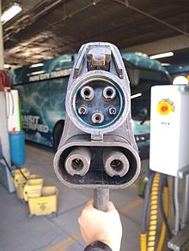
CP – Control Pilot (Communications) used to relay data between EVSE (electric vehicle supply equipment) and charger how much current is needed.
PP – Proximity Pilot keeps vehicle from moving or also called safety/proximity pin.
PE – Protective Earth is a 6mm round pin that supplies earth ground for the A/C power and connects to vehicle ground circuit.
L1 – Single Phase A/C power 120 volts
L2 – Single Phase A/C power 120 volts

